Slide 1
POCKETEXEC TEMPLATE LIBRARY
Combined Available Visual Contracts
This reference deck combines 80 local data-format slides rendered from the available HTML visual contracts. It is a visual/template reference for tool ingestion, not an editable final-output implementation. PPTX editable slot rendering still requires registry + slot renderer implementation.
Available: 80 · Missing format numbers from local visual contracts: 2, 5, 7, 8, 9, 11, 12, 13, 14, 15, 16, 20, 21, 23, 24, 25, 26, 29, 30, 34, 35, 36
Source folder: /Users/openclaw2/Downloads/PocketExec Slide templates

Slide 2

001 · fmt-01-verdict-seal-cover
Notes:
format_id: fmt-01-verdict-seal-cover
format_number: 1
title: Verdict Seal Cover
source_html: /Users/openclaw2/Downloads/PocketExec Slide templates/pocket_exec_01_102_final_handoff/source_assets/pocket_exec_20_rebuilt_formats_design2_v2.html
authority: files (9).zip
rendered_png: /Users/openclaw2/Downloads/PocketExec Slide templates/pocket_exec_01_102_final_handoff/rendered_template_png/001_fmt-01-verdict-seal-cover.png

Slide 3
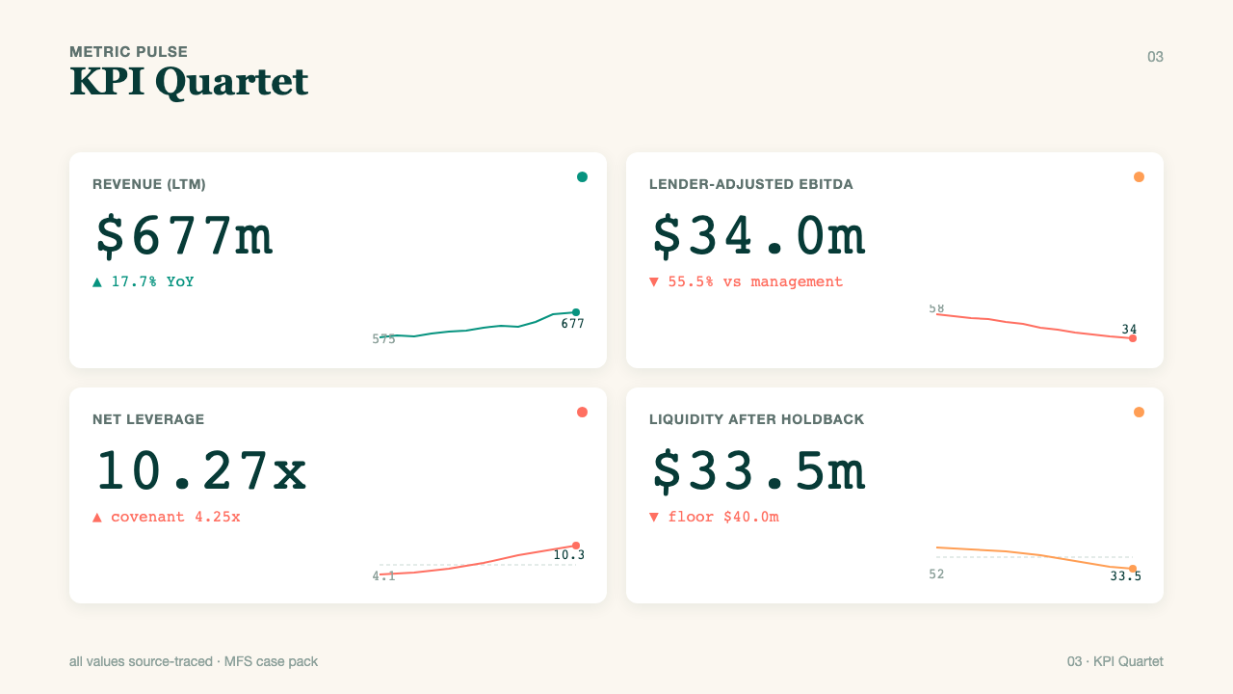
003 · fmt-03-kpi-quartet
Notes:
format_id: fmt-03-kpi-quartet
format_number: 3
title: Kpi Quartet
source_html: /Users/openclaw2/Downloads/PocketExec Slide templates/pocket_exec_01_102_final_handoff/source_assets/pocket_exec_20_rebuilt_formats_design2_v2.html
authority: files (9).zip
rendered_png: /Users/openclaw2/Downloads/PocketExec Slide templates/pocket_exec_01_102_final_handoff/rendered_template_png/003_fmt-03-kpi-quartet.png

Slide 4
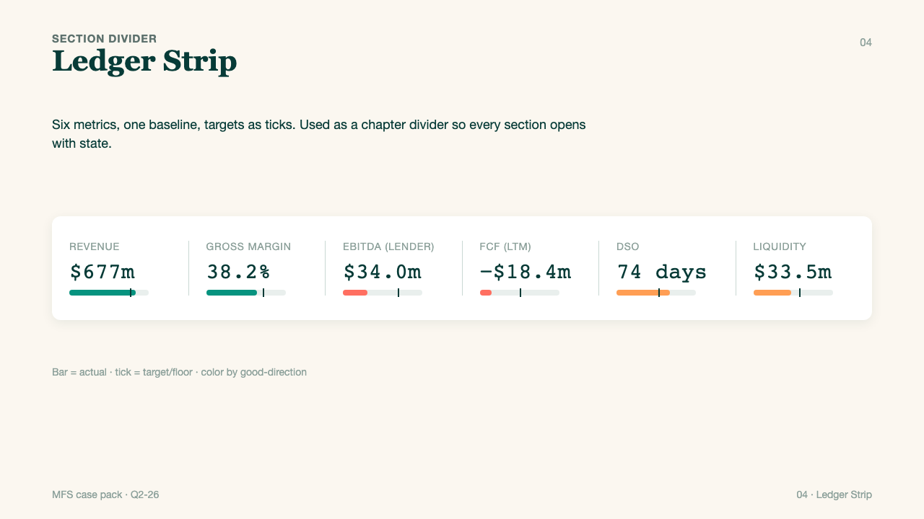
004 · fmt-04-ledger-strip
Notes:
format_id: fmt-04-ledger-strip
format_number: 4
title: Ledger Strip
source_html: /Users/openclaw2/Downloads/PocketExec Slide templates/pocket_exec_01_102_final_handoff/source_assets/pocket_exec_20_rebuilt_formats_design2_v2.html
authority: files (9).zip
rendered_png: /Users/openclaw2/Downloads/PocketExec Slide templates/pocket_exec_01_102_final_handoff/rendered_template_png/004_fmt-04-ledger-strip.png

Slide 5
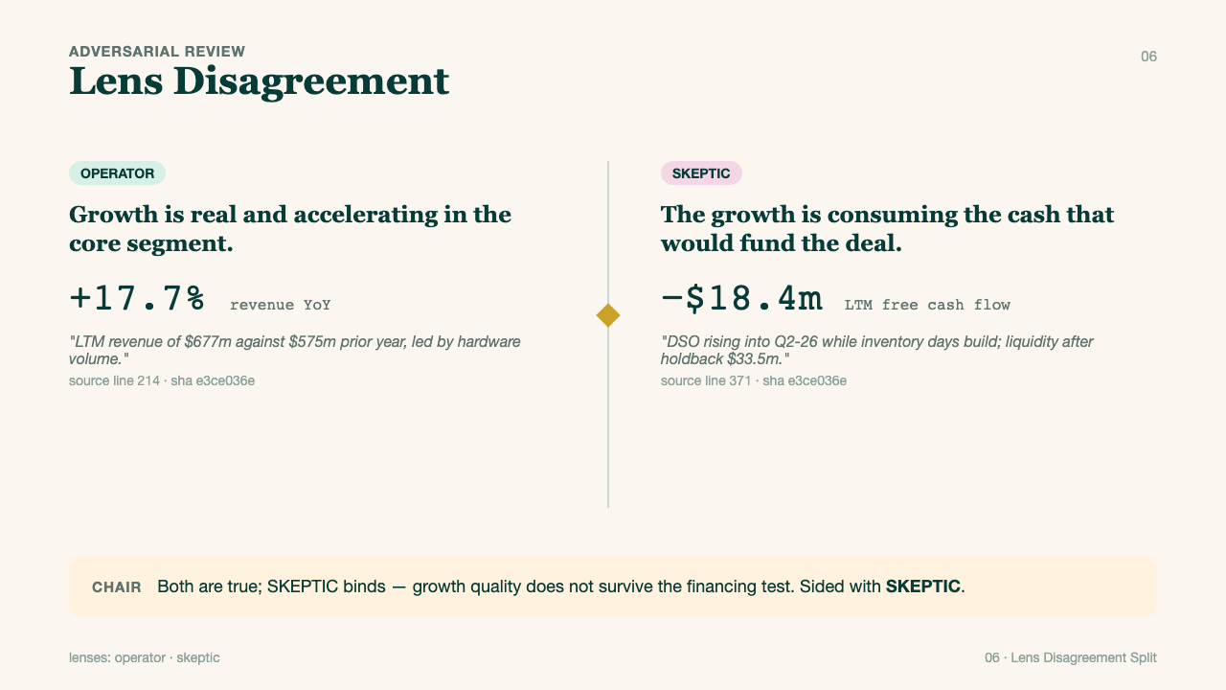
006 · fmt-06-lens-split
Notes:
format_id: fmt-06-lens-split
format_number: 6
title: Lens Split
source_html: /Users/openclaw2/Downloads/PocketExec Slide templates/pocket_exec_01_102_final_handoff/source_assets/pocket_exec_20_rebuilt_formats_design2_v2.html
authority: files (9).zip
rendered_png: /Users/openclaw2/Downloads/PocketExec Slide templates/pocket_exec_01_102_final_handoff/rendered_template_png/006_fmt-06-lens-split.png

Slide 6
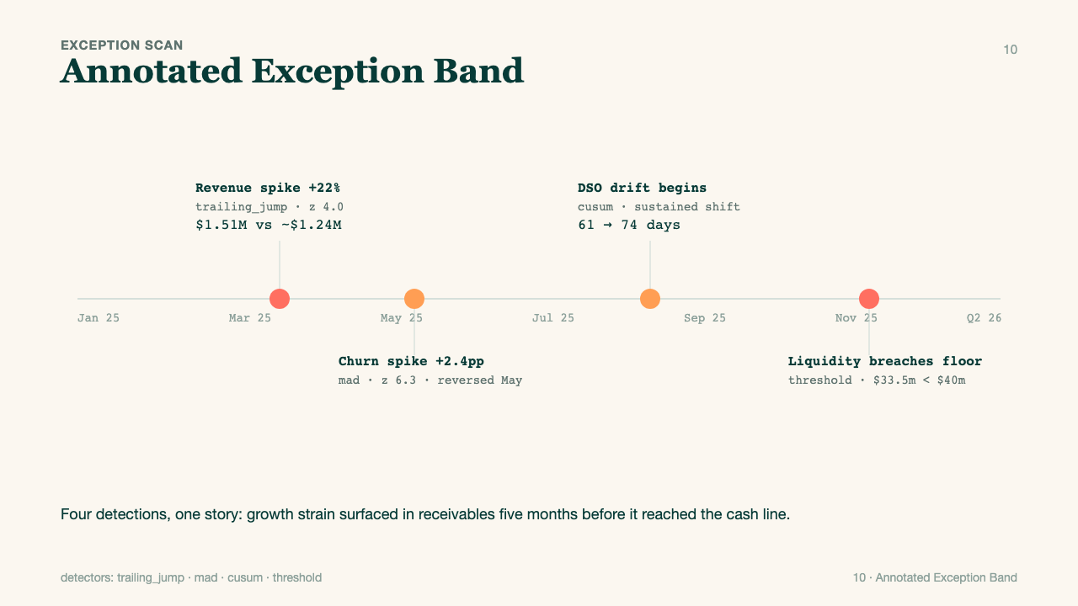
010 · fmt-10-exception-band
Notes:
format_id: fmt-10-exception-band
format_number: 10
title: Exception Band
source_html: /Users/openclaw2/Downloads/PocketExec Slide templates/pocket_exec_01_102_final_handoff/source_assets/pocket_exec_20_rebuilt_formats_design2_v2.html
authority: files (9).zip
rendered_png: /Users/openclaw2/Downloads/PocketExec Slide templates/pocket_exec_01_102_final_handoff/rendered_template_png/010_fmt-10-exception-band.png

Slide 7
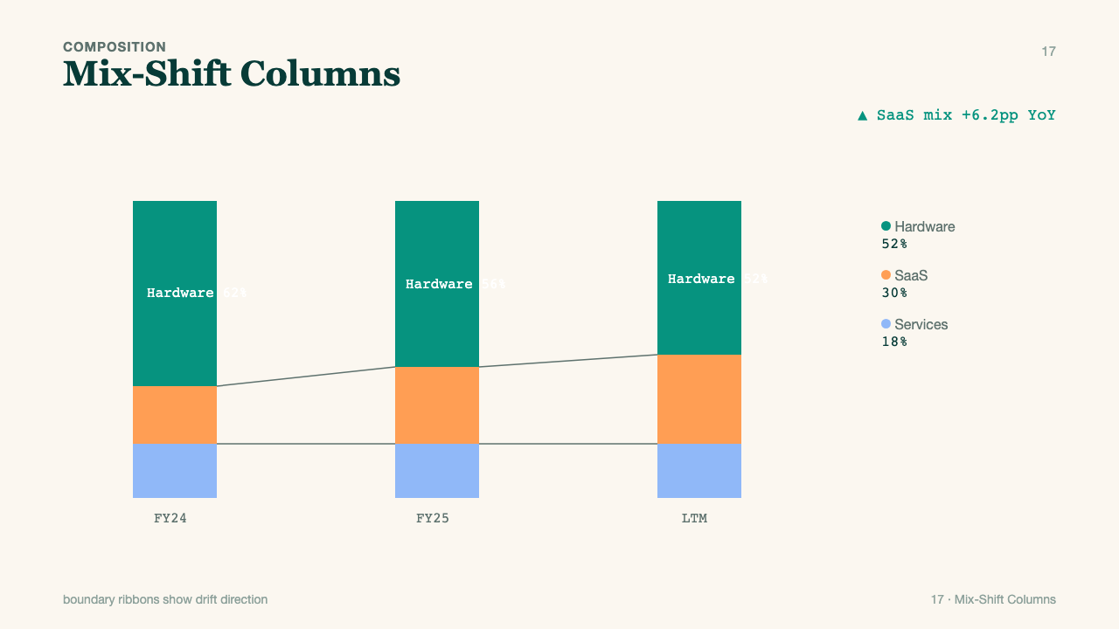
017 · fmt-17-mix-shift
Notes:
format_id: fmt-17-mix-shift
format_number: 17
title: Mix Shift
source_html: /Users/openclaw2/Downloads/PocketExec Slide templates/pocket_exec_01_102_final_handoff/source_assets/pocket_exec_20_rebuilt_formats_design2_v2.html
authority: files (9).zip
rendered_png: /Users/openclaw2/Downloads/PocketExec Slide templates/pocket_exec_01_102_final_handoff/rendered_template_png/017_fmt-17-mix-shift.png

Slide 8
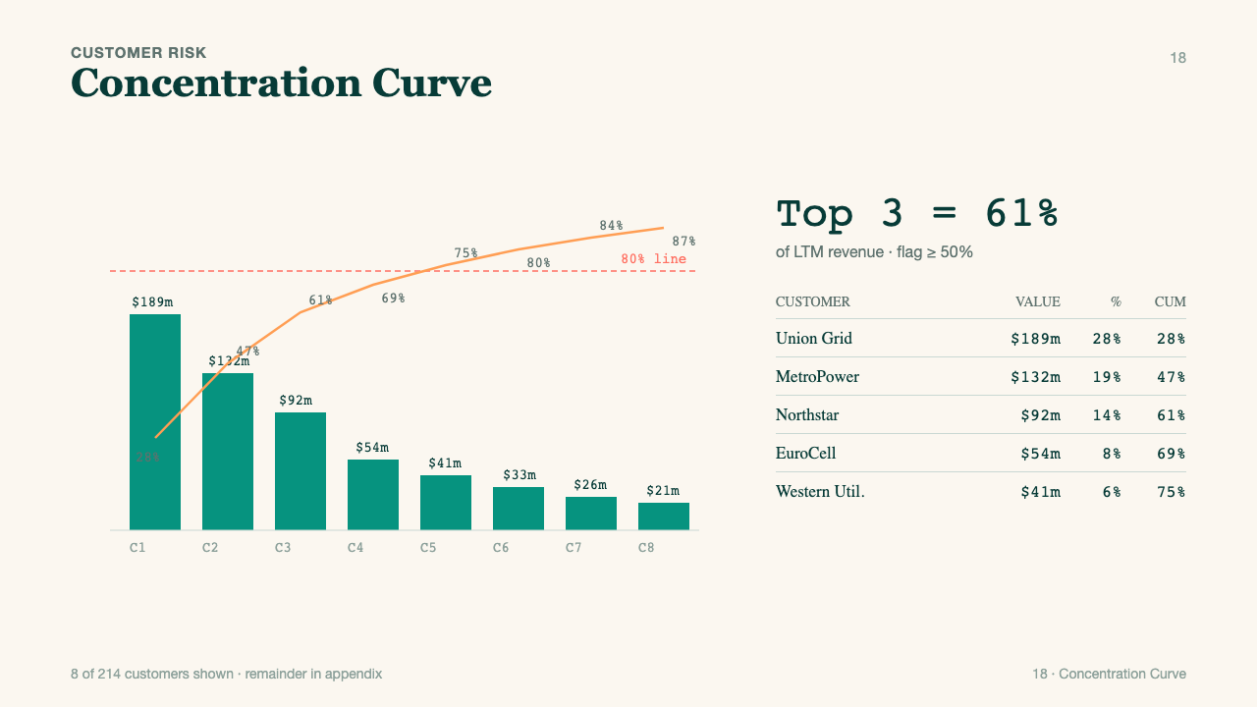
018 · fmt-18-concentration
Notes:
format_id: fmt-18-concentration
format_number: 18
title: Concentration
source_html: /Users/openclaw2/Downloads/PocketExec Slide templates/pocket_exec_01_102_final_handoff/source_assets/pocket_exec_20_rebuilt_formats_design2_v2.html
authority: files (9).zip
rendered_png: /Users/openclaw2/Downloads/PocketExec Slide templates/pocket_exec_01_102_final_handoff/rendered_template_png/018_fmt-18-concentration.png

Slide 9
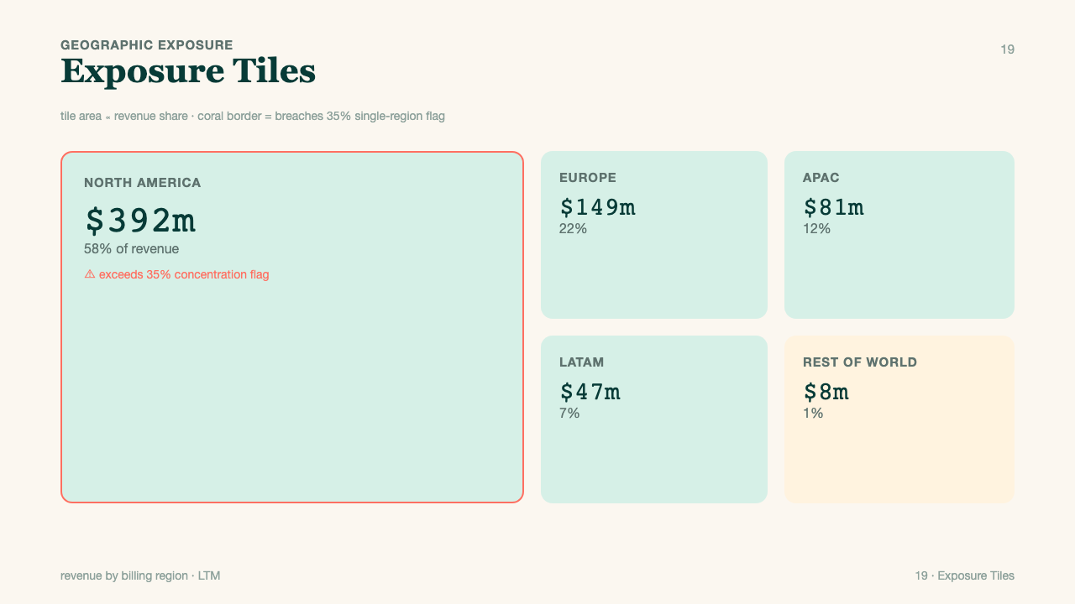
019 · fmt-19-exposure-tiles
Notes:
format_id: fmt-19-exposure-tiles
format_number: 19
title: Exposure Tiles
source_html: /Users/openclaw2/Downloads/PocketExec Slide templates/pocket_exec_01_102_final_handoff/source_assets/pocket_exec_20_rebuilt_formats_design2_v2.html
authority: files (9).zip
rendered_png: /Users/openclaw2/Downloads/PocketExec Slide templates/pocket_exec_01_102_final_handoff/rendered_template_png/019_fmt-19-exposure-tiles.png

Slide 10
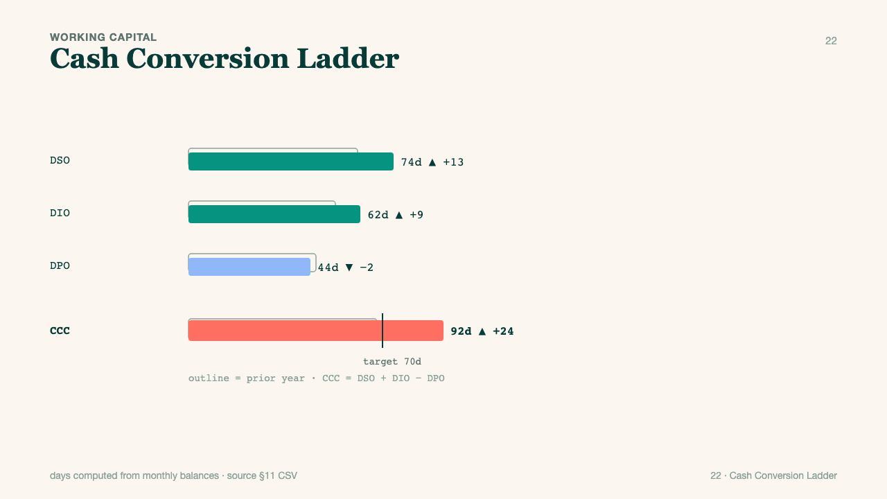
022 · fmt-22-ccc-ladder
Notes:
format_id: fmt-22-ccc-ladder
format_number: 22
title: Ccc Ladder
source_html: /Users/openclaw2/Downloads/PocketExec Slide templates/pocket_exec_01_102_final_handoff/source_assets/pocket_exec_20_rebuilt_formats_design2_v2.html
authority: files (9).zip
rendered_png: /Users/openclaw2/Downloads/PocketExec Slide templates/pocket_exec_01_102_final_handoff/rendered_template_png/022_fmt-22-ccc-ladder.png

Slide 11
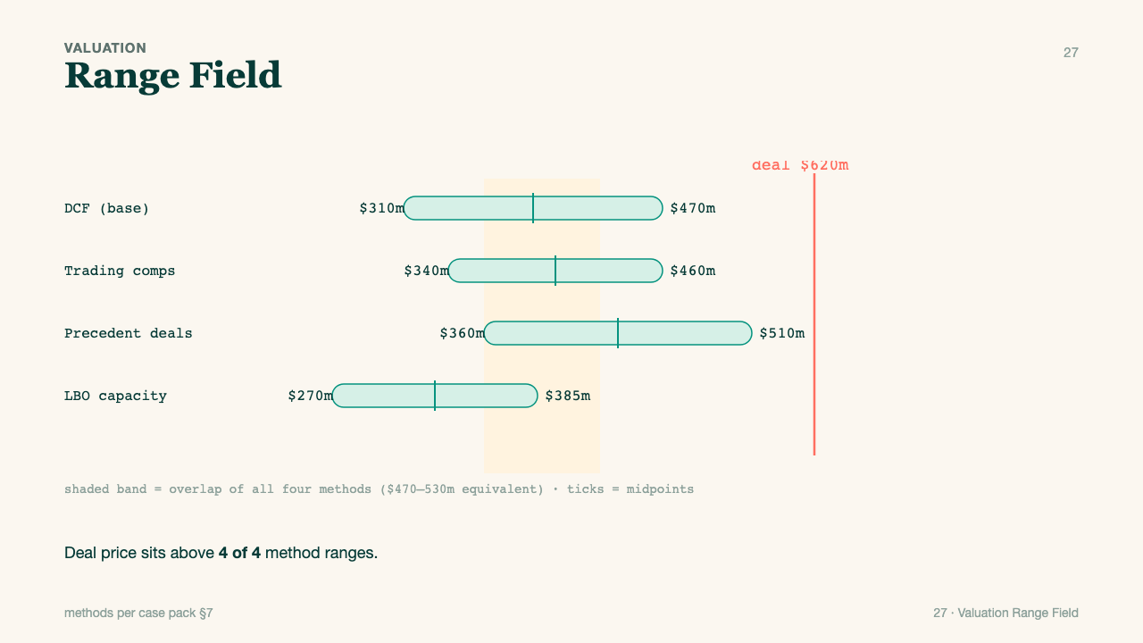
027 · fmt-27-range-field
Notes:
format_id: fmt-27-range-field
format_number: 27
title: Range Field
source_html: /Users/openclaw2/Downloads/PocketExec Slide templates/pocket_exec_01_102_final_handoff/source_assets/pocket_exec_20_rebuilt_formats_design2_v2.html
authority: files (9).zip
rendered_png: /Users/openclaw2/Downloads/PocketExec Slide templates/pocket_exec_01_102_final_handoff/rendered_template_png/027_fmt-27-range-field.png

Slide 12
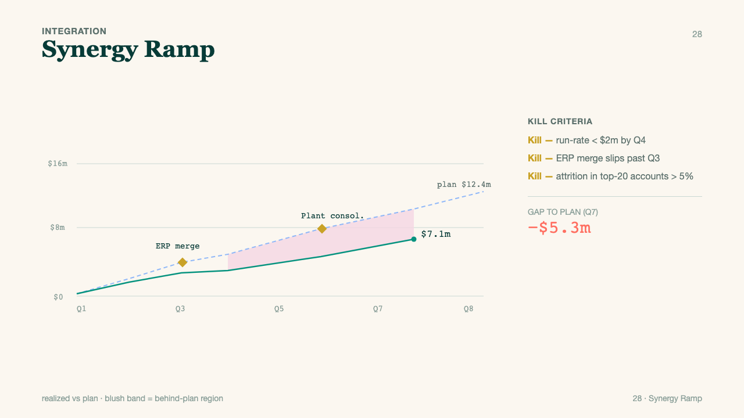
028 · fmt-28-synergy-ramp
Notes:
format_id: fmt-28-synergy-ramp
format_number: 28
title: Synergy Ramp
source_html: /Users/openclaw2/Downloads/PocketExec Slide templates/pocket_exec_01_102_final_handoff/source_assets/pocket_exec_20_rebuilt_formats_design2_v2.html
authority: files (9).zip
rendered_png: /Users/openclaw2/Downloads/PocketExec Slide templates/pocket_exec_01_102_final_handoff/rendered_template_png/028_fmt-28-synergy-ramp.png

Slide 13
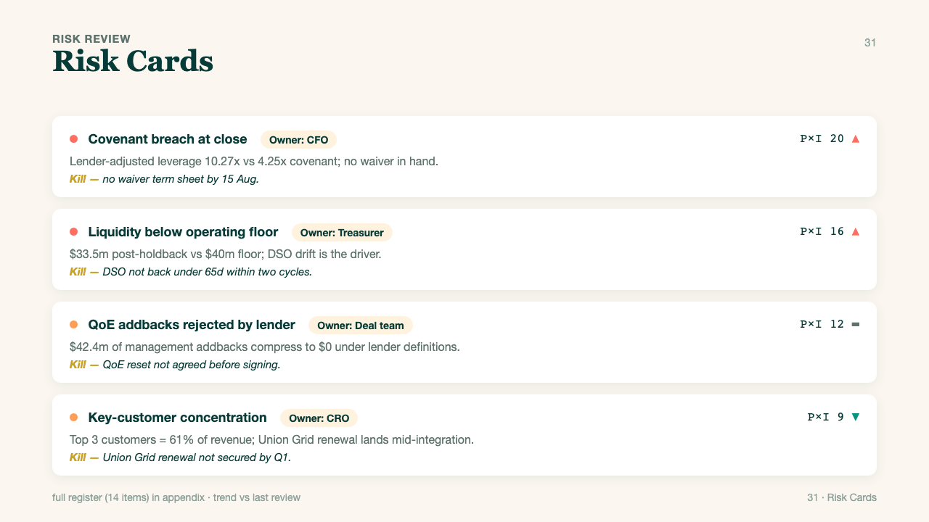
031 · fmt-31-risk-cards
Notes:
format_id: fmt-31-risk-cards
format_number: 31
title: Risk Cards
source_html: /Users/openclaw2/Downloads/PocketExec Slide templates/pocket_exec_01_102_final_handoff/source_assets/pocket_exec_20_rebuilt_formats_design2_v2.html
authority: files (9).zip
rendered_png: /Users/openclaw2/Downloads/PocketExec Slide templates/pocket_exec_01_102_final_handoff/rendered_template_png/031_fmt-31-risk-cards.png

Slide 14
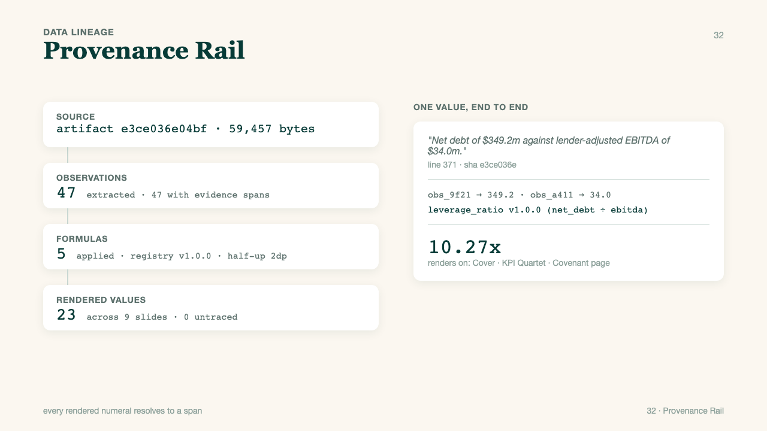
032 · fmt-32-provenance-rail
Notes:
format_id: fmt-32-provenance-rail
format_number: 32
title: Provenance Rail
source_html: /Users/openclaw2/Downloads/PocketExec Slide templates/pocket_exec_01_102_final_handoff/source_assets/pocket_exec_20_rebuilt_formats_design2_v2.html
authority: files (9).zip
rendered_png: /Users/openclaw2/Downloads/PocketExec Slide templates/pocket_exec_01_102_final_handoff/rendered_template_png/032_fmt-32-provenance-rail.png

Slide 15
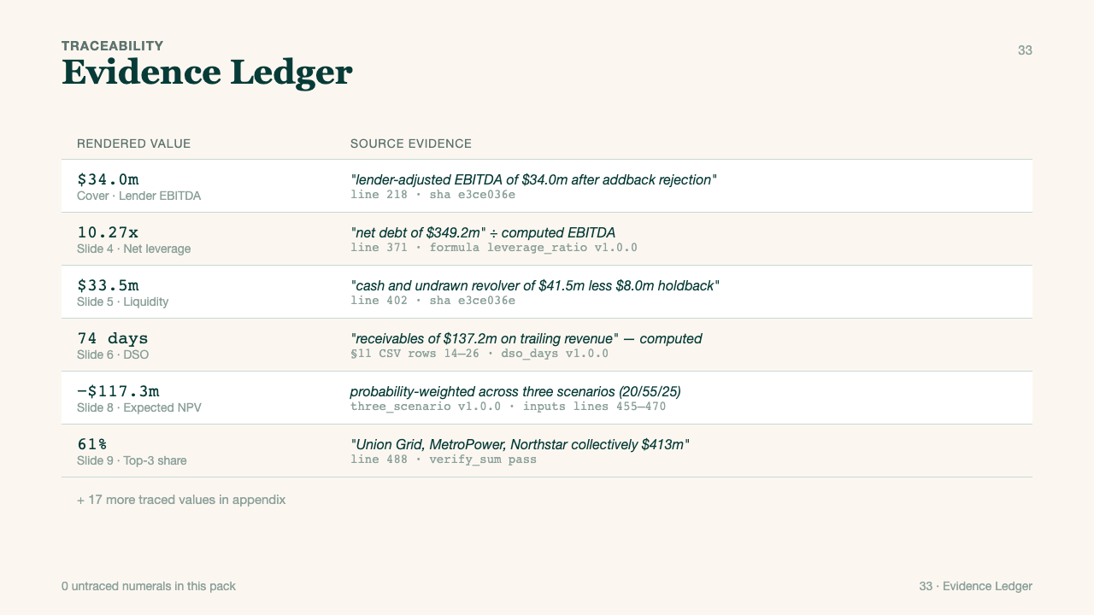
033 · fmt-33-evidence-ledger
Notes:
format_id: fmt-33-evidence-ledger
format_number: 33
title: Evidence Ledger
source_html: /Users/openclaw2/Downloads/PocketExec Slide templates/pocket_exec_01_102_final_handoff/source_assets/pocket_exec_20_rebuilt_formats_design2_v2.html
authority: files (9).zip
rendered_png: /Users/openclaw2/Downloads/PocketExec Slide templates/pocket_exec_01_102_final_handoff/rendered_template_png/033_fmt-33-evidence-ledger.png

Slide 16
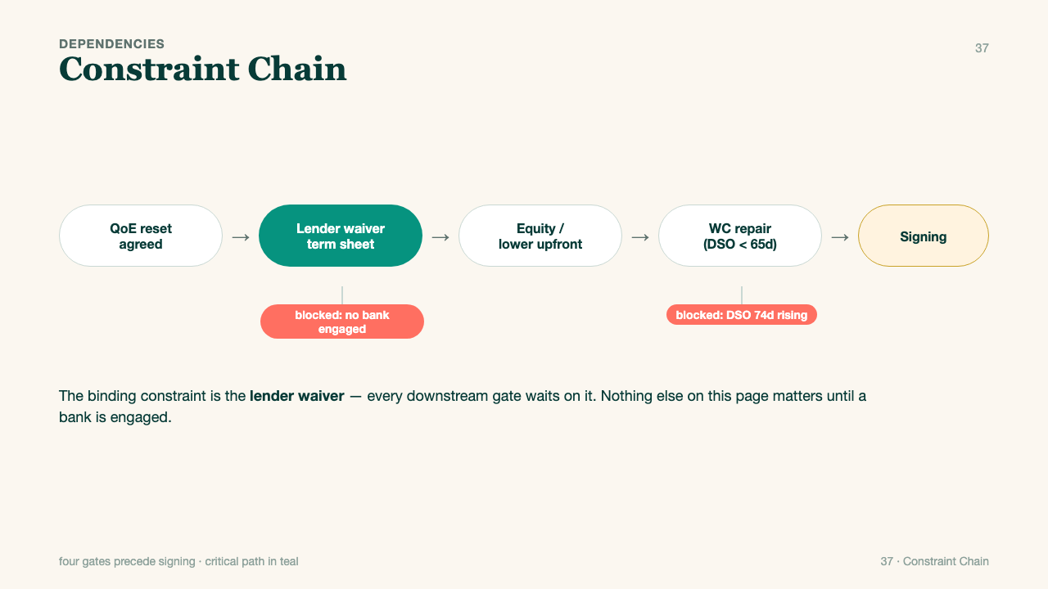
037 · fmt-37-constraint-chain
Notes:
format_id: fmt-37-constraint-chain
format_number: 37
title: Constraint Chain
source_html: /Users/openclaw2/Downloads/PocketExec Slide templates/pocket_exec_01_102_final_handoff/source_assets/pocket_exec_20_rebuilt_formats_design2_v2.html
authority: files (9).zip
rendered_png: /Users/openclaw2/Downloads/PocketExec Slide templates/pocket_exec_01_102_final_handoff/rendered_template_png/037_fmt-37-constraint-chain.png

Slide 17
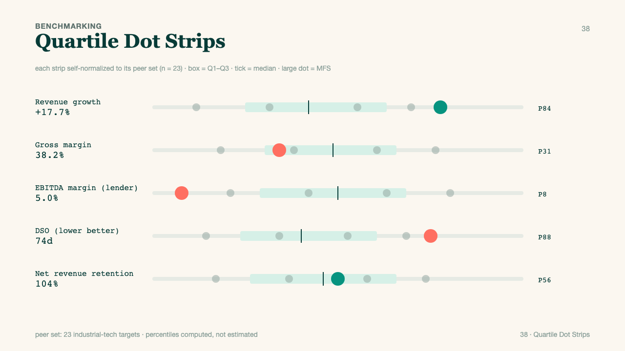
038 · fmt-38-quartile-strips
Notes:
format_id: fmt-38-quartile-strips
format_number: 38
title: Quartile Strips
source_html: /Users/openclaw2/Downloads/PocketExec Slide templates/pocket_exec_01_102_final_handoff/source_assets/pocket_exec_20_rebuilt_formats_design2_v2.html
authority: files (9).zip
rendered_png: /Users/openclaw2/Downloads/PocketExec Slide templates/pocket_exec_01_102_final_handoff/rendered_template_png/038_fmt-38-quartile-strips.png

Slide 18
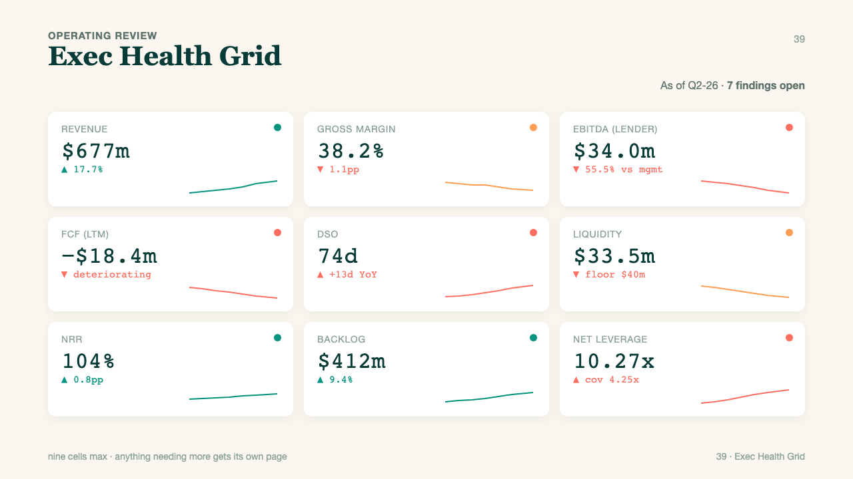
039 · fmt-39-health-grid
Notes:
format_id: fmt-39-health-grid
format_number: 39
title: Health Grid
source_html: /Users/openclaw2/Downloads/PocketExec Slide templates/pocket_exec_01_102_final_handoff/source_assets/pocket_exec_20_rebuilt_formats_design2_v2.html
authority: files (9).zip
rendered_png: /Users/openclaw2/Downloads/PocketExec Slide templates/pocket_exec_01_102_final_handoff/rendered_template_png/039_fmt-39-health-grid.png

Slide 19
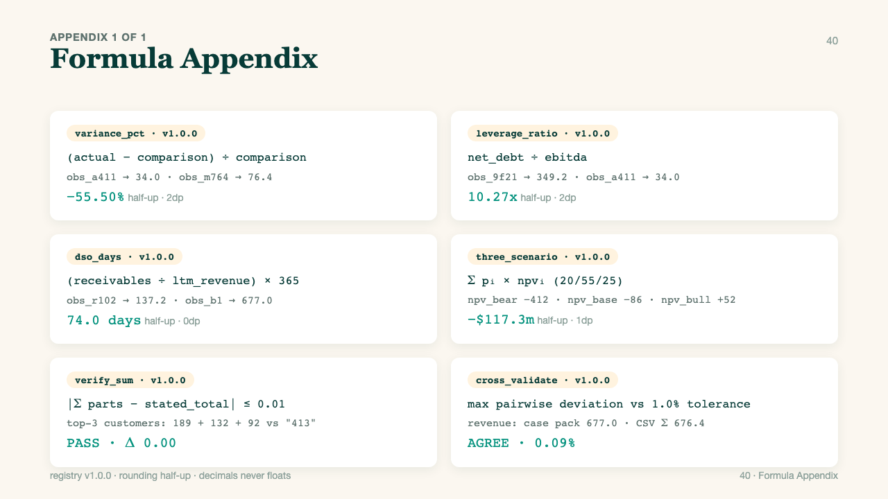
040 · fmt-40-formula-appendix
Notes:
format_id: fmt-40-formula-appendix
format_number: 40
title: Formula Appendix
source_html: /Users/openclaw2/Downloads/PocketExec Slide templates/pocket_exec_01_102_final_handoff/source_assets/pocket_exec_20_rebuilt_formats_design2_v2.html
authority: files (9).zip
rendered_png: /Users/openclaw2/Downloads/PocketExec Slide templates/pocket_exec_01_102_final_handoff/rendered_template_png/040_fmt-40-formula-appendix.png

Slide 20
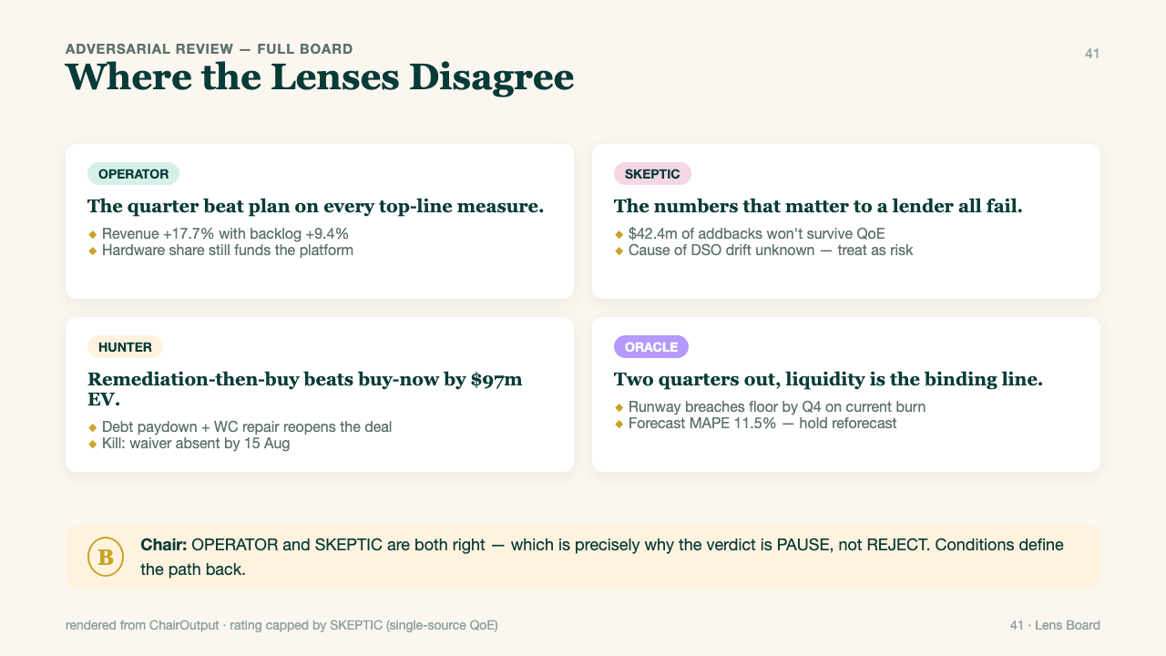
041 · fmt-41-lens-board
Notes:
format_id: fmt-41-lens-board
format_number: 41
title: Lens Board
source_html: /Users/openclaw2/Downloads/PocketExec Slide templates/pocket_exec_01_102_final_handoff/source_assets/pocket_exec_20_rebuilt_formats_design2_v2.html
authority: files (9).zip
rendered_png: /Users/openclaw2/Downloads/PocketExec Slide templates/pocket_exec_01_102_final_handoff/rendered_template_png/041_fmt-41-lens-board.png

Slide 21
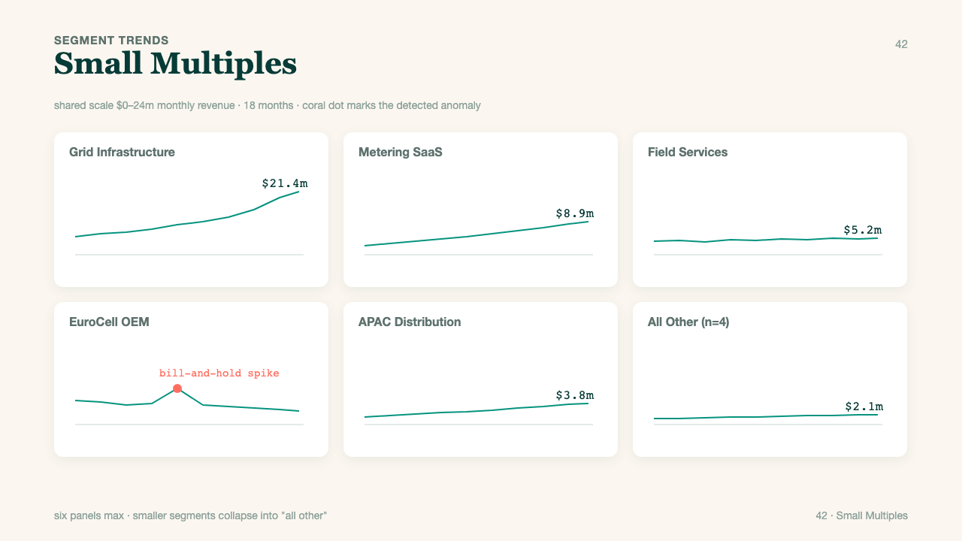
042 · fmt-42-small-multiples
Notes:
format_id: fmt-42-small-multiples
format_number: 42
title: Small Multiples
source_html: /Users/openclaw2/Downloads/PocketExec Slide templates/pocket_exec_01_102_final_handoff/source_assets/pocket_exec_20_rebuilt_formats_design2_v2.html
authority: files (9).zip
rendered_png: /Users/openclaw2/Downloads/PocketExec Slide templates/pocket_exec_01_102_final_handoff/rendered_template_png/042_fmt-42-small-multiples.png

Slide 22
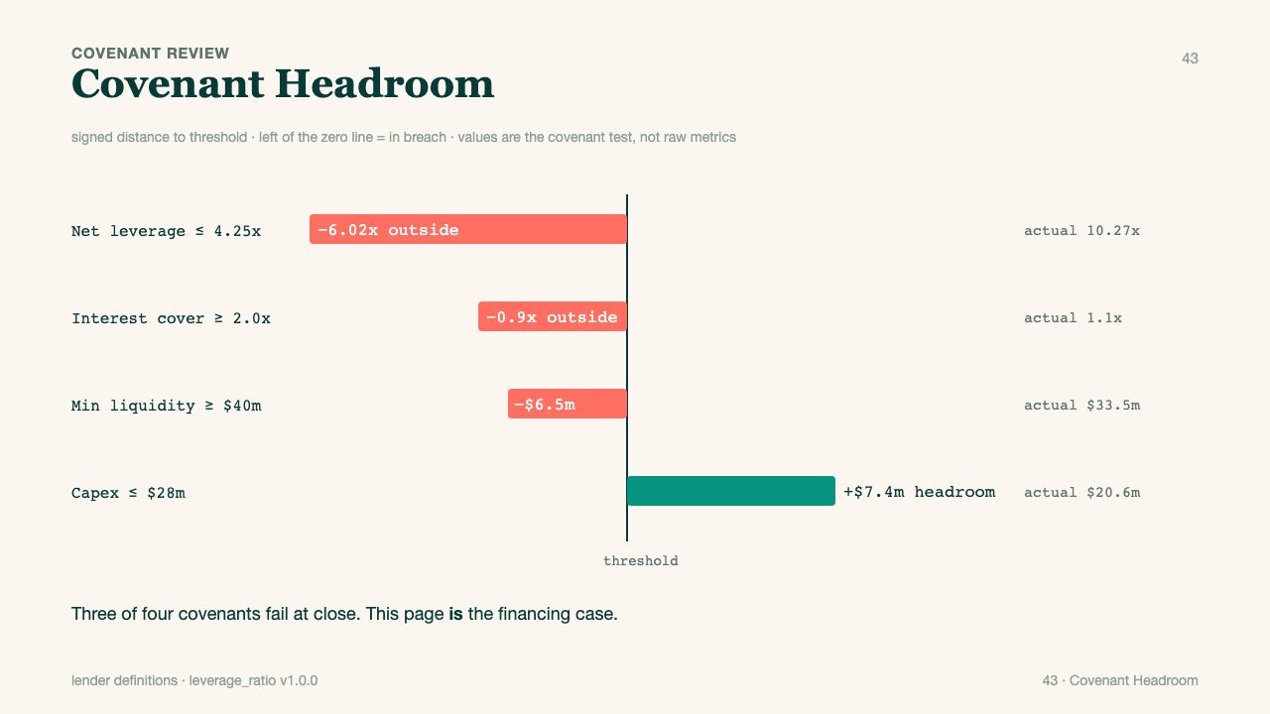
043 · fmt-43-covenant-headroom
Notes:
format_id: fmt-43-covenant-headroom
format_number: 43
title: Covenant Headroom
source_html: /Users/openclaw2/Downloads/PocketExec Slide templates/pocket_exec_01_102_final_handoff/source_assets/pocket_exec_formats_43_62_design2_v2.html
authority: files (10).zip
rendered_png: /Users/openclaw2/Downloads/PocketExec Slide templates/pocket_exec_01_102_final_handoff/rendered_template_png/043_fmt-43-covenant-headroom.png

Slide 23
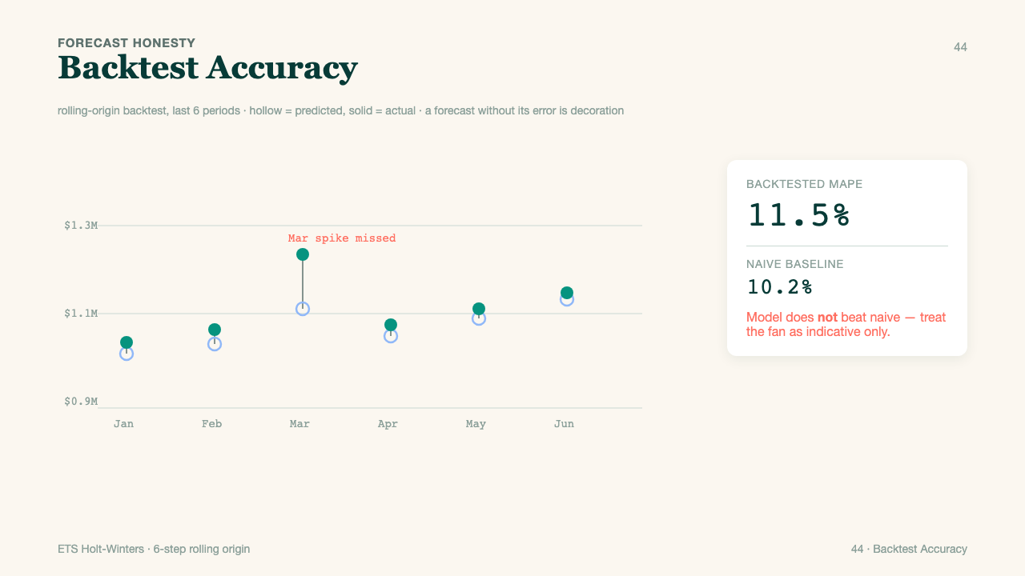
044 · fmt-44-backtest-strip
Notes:
format_id: fmt-44-backtest-strip
format_number: 44
title: Backtest Strip
source_html: /Users/openclaw2/Downloads/PocketExec Slide templates/pocket_exec_01_102_final_handoff/source_assets/pocket_exec_formats_43_62_design2_v2.html
authority: files (10).zip
rendered_png: /Users/openclaw2/Downloads/PocketExec Slide templates/pocket_exec_01_102_final_handoff/rendered_template_png/044_fmt-44-backtest-strip.png

Slide 24
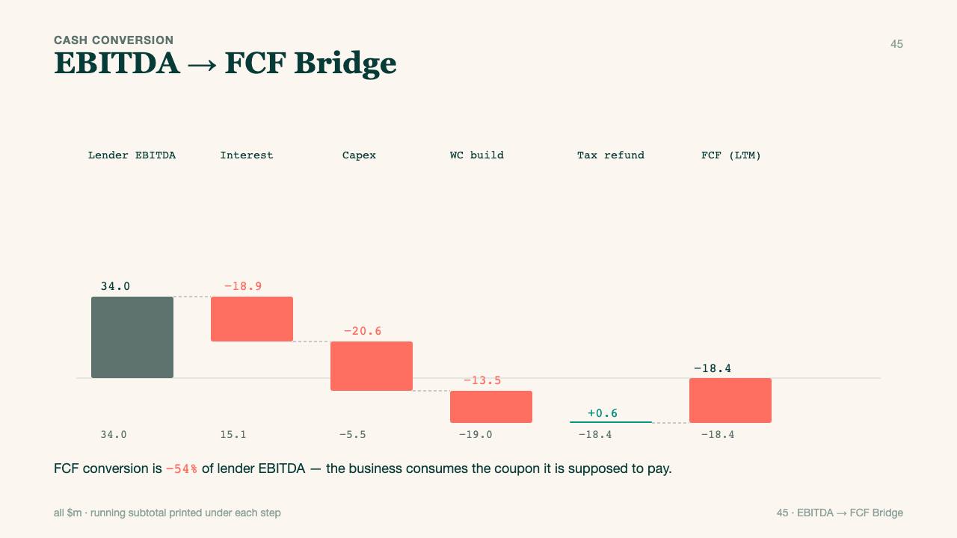
045 · fmt-45-fcf-bridge
Notes:
format_id: fmt-45-fcf-bridge
format_number: 45
title: Fcf Bridge
source_html: /Users/openclaw2/Downloads/PocketExec Slide templates/pocket_exec_01_102_final_handoff/source_assets/pocket_exec_formats_43_62_design2_v2.html
authority: files (10).zip
rendered_png: /Users/openclaw2/Downloads/PocketExec Slide templates/pocket_exec_01_102_final_handoff/rendered_template_png/045_fmt-45-fcf-bridge.png

Slide 25
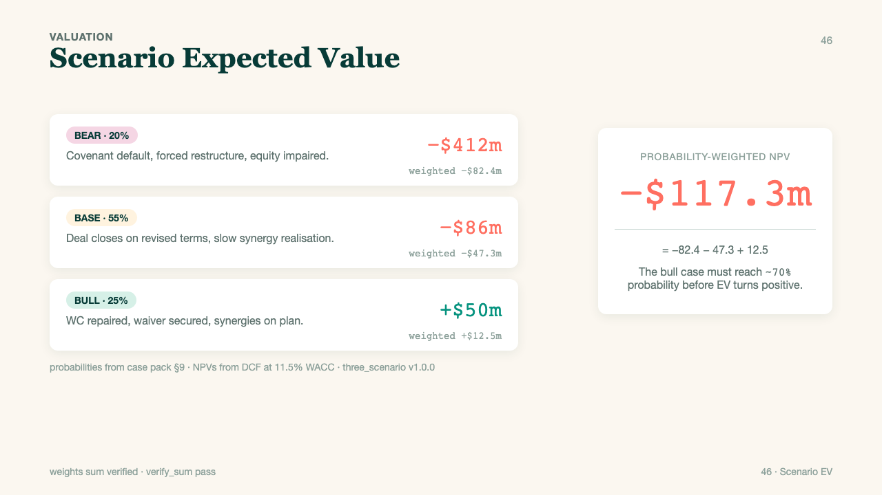
046 · fmt-46-scenario-ev
Notes:
format_id: fmt-46-scenario-ev
format_number: 46
title: Scenario Ev
source_html: /Users/openclaw2/Downloads/PocketExec Slide templates/pocket_exec_01_102_final_handoff/source_assets/pocket_exec_formats_43_62_design2_v2.html
authority: files (10).zip
rendered_png: /Users/openclaw2/Downloads/PocketExec Slide templates/pocket_exec_01_102_final_handoff/rendered_template_png/046_fmt-46-scenario-ev.png

Slide 26
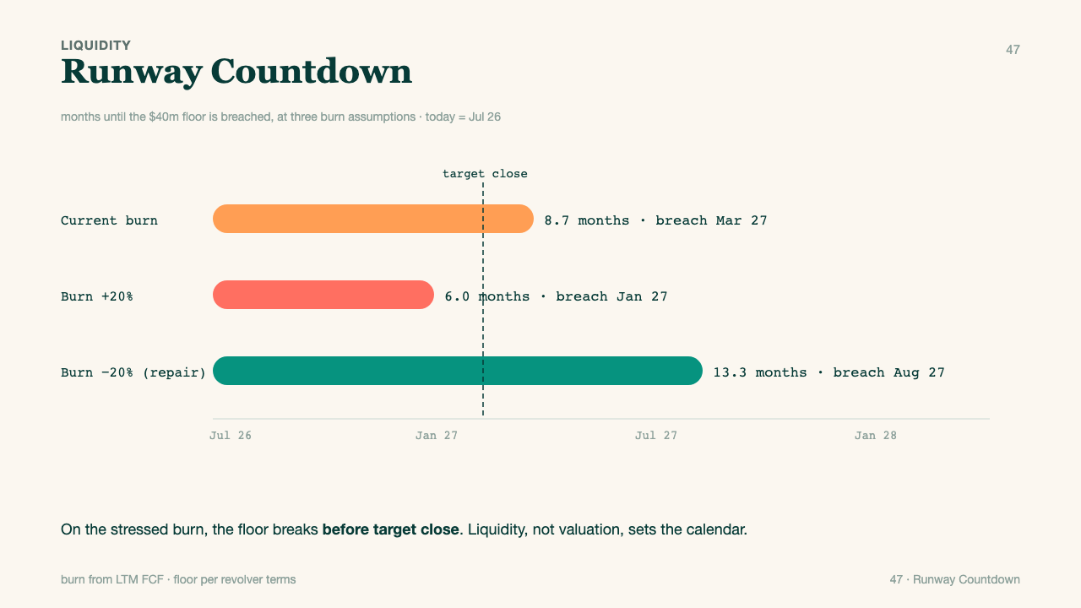
047 · fmt-47-runway
Notes:
format_id: fmt-47-runway
format_number: 47
title: Runway
source_html: /Users/openclaw2/Downloads/PocketExec Slide templates/pocket_exec_01_102_final_handoff/source_assets/pocket_exec_formats_43_62_design2_v2.html
authority: files (10).zip
rendered_png: /Users/openclaw2/Downloads/PocketExec Slide templates/pocket_exec_01_102_final_handoff/rendered_template_png/047_fmt-47-runway.png

Slide 27
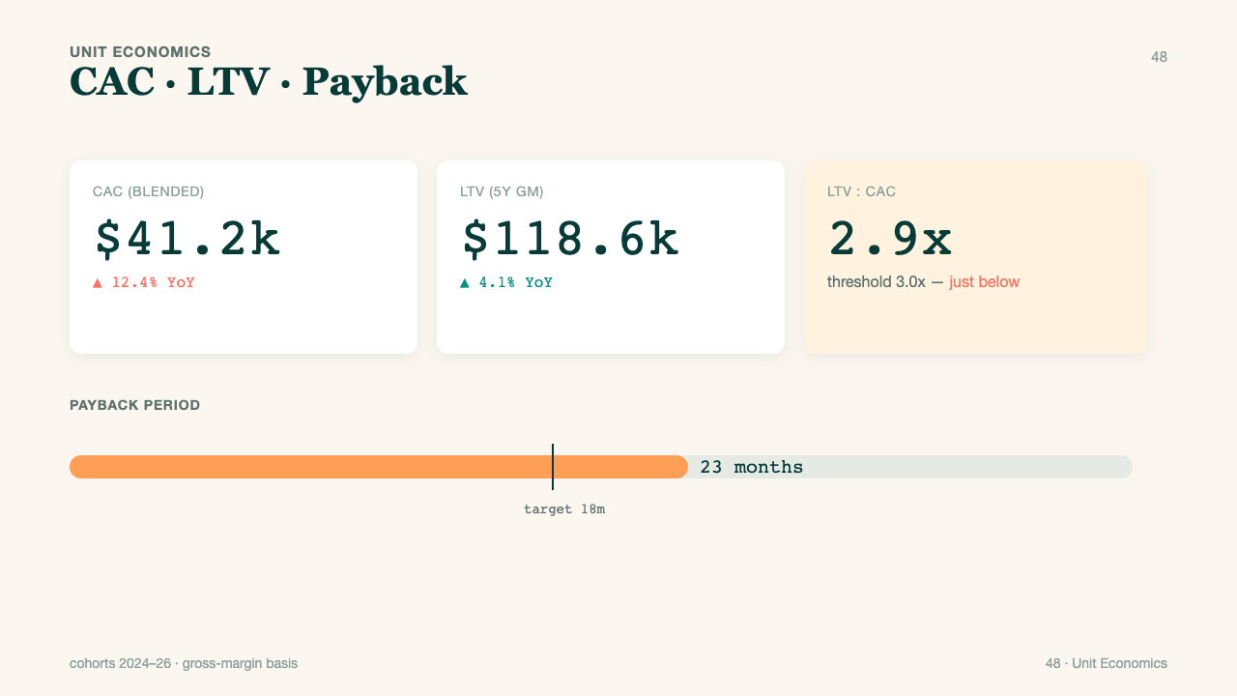
048 · fmt-48-unit-econ
Notes:
format_id: fmt-48-unit-econ
format_number: 48
title: Unit Econ
source_html: /Users/openclaw2/Downloads/PocketExec Slide templates/pocket_exec_01_102_final_handoff/source_assets/pocket_exec_formats_43_62_design2_v2.html
authority: files (10).zip
rendered_png: /Users/openclaw2/Downloads/PocketExec Slide templates/pocket_exec_01_102_final_handoff/rendered_template_png/048_fmt-48-unit-econ.png

Slide 28
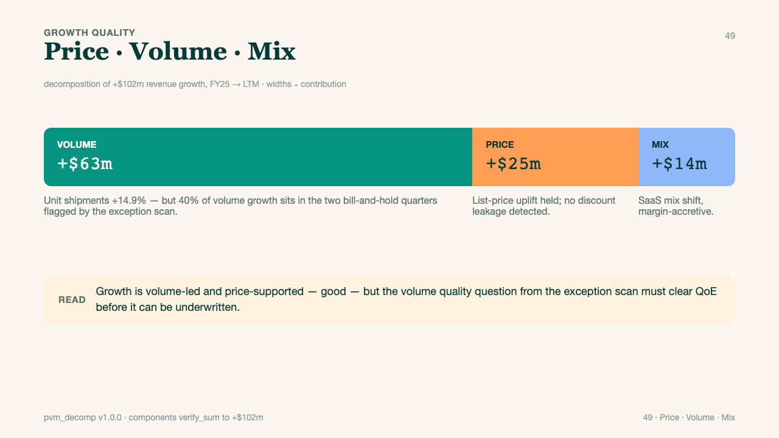
049 · fmt-49-pvm
Notes:
format_id: fmt-49-pvm
format_number: 49
title: Pvm
source_html: /Users/openclaw2/Downloads/PocketExec Slide templates/pocket_exec_01_102_final_handoff/source_assets/pocket_exec_formats_43_62_design2_v2.html
authority: files (10).zip
rendered_png: /Users/openclaw2/Downloads/PocketExec Slide templates/pocket_exec_01_102_final_handoff/rendered_template_png/049_fmt-49-pvm.png

Slide 29
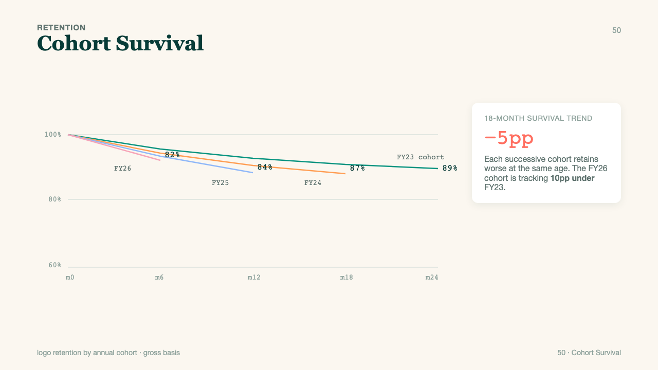
050 · fmt-50-cohort-survival
Notes:
format_id: fmt-50-cohort-survival
format_number: 50
title: Cohort Survival
source_html: /Users/openclaw2/Downloads/PocketExec Slide templates/pocket_exec_01_102_final_handoff/source_assets/pocket_exec_formats_43_62_design2_v2.html
authority: files (10).zip
rendered_png: /Users/openclaw2/Downloads/PocketExec Slide templates/pocket_exec_01_102_final_handoff/rendered_template_png/050_fmt-50-cohort-survival.png

Slide 30
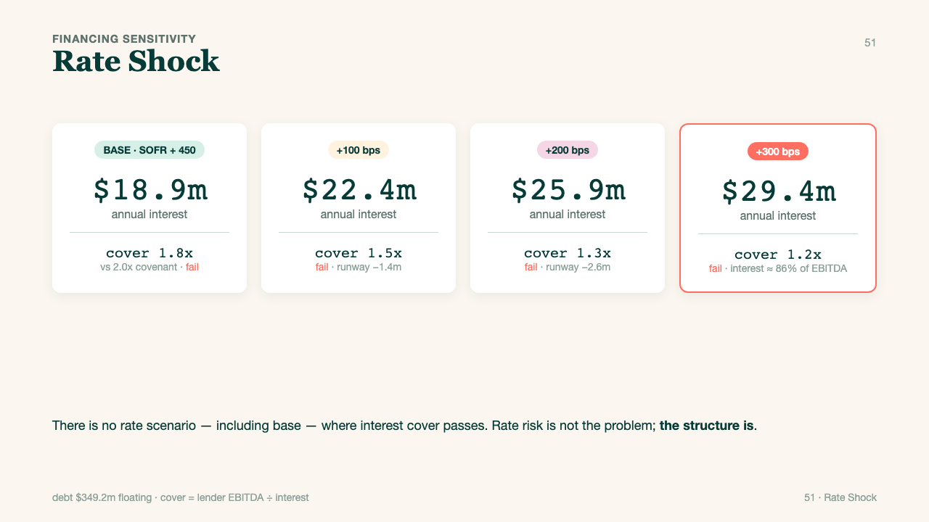
051 · fmt-51-rate-shock
Notes:
format_id: fmt-51-rate-shock
format_number: 51
title: Rate Shock
source_html: /Users/openclaw2/Downloads/PocketExec Slide templates/pocket_exec_01_102_final_handoff/source_assets/pocket_exec_formats_43_62_design2_v2.html
authority: files (10).zip
rendered_png: /Users/openclaw2/Downloads/PocketExec Slide templates/pocket_exec_01_102_final_handoff/rendered_template_png/051_fmt-51-rate-shock.png

Slide 31
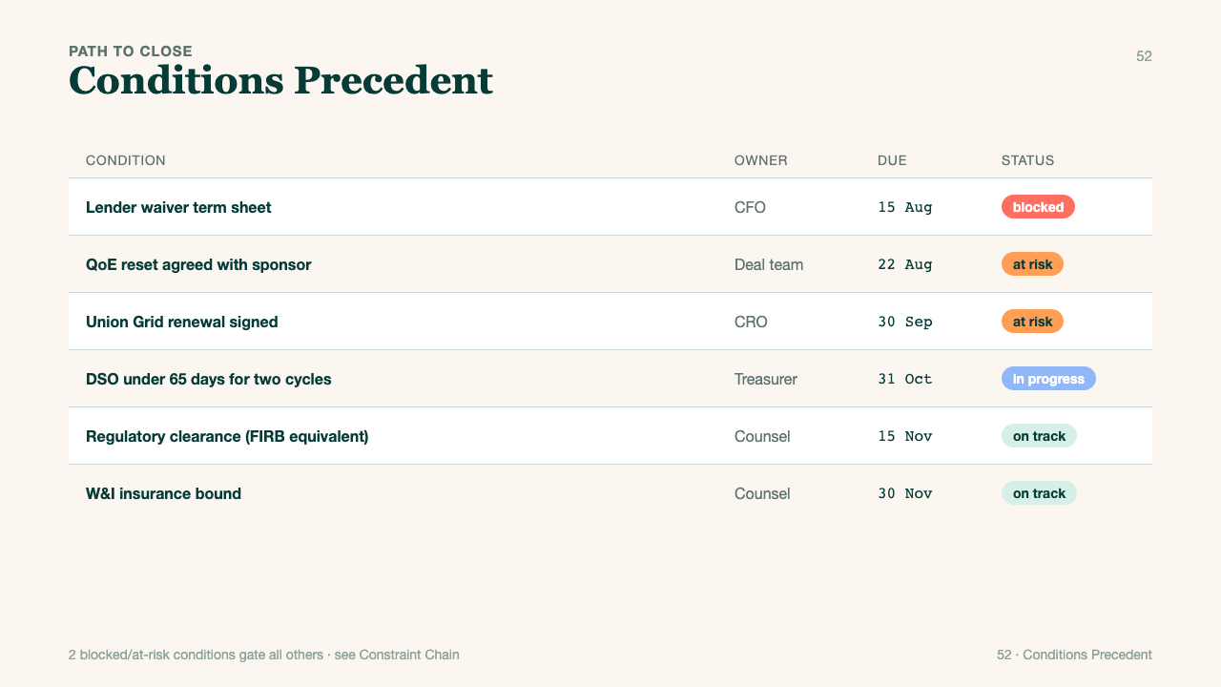
052 · fmt-52-cp-tracker
Notes:
format_id: fmt-52-cp-tracker
format_number: 52
title: Cp Tracker
source_html: /Users/openclaw2/Downloads/PocketExec Slide templates/pocket_exec_01_102_final_handoff/source_assets/pocket_exec_formats_43_62_design2_v2.html
authority: files (10).zip
rendered_png: /Users/openclaw2/Downloads/PocketExec Slide templates/pocket_exec_01_102_final_handoff/rendered_template_png/052_fmt-52-cp-tracker.png

Slide 32
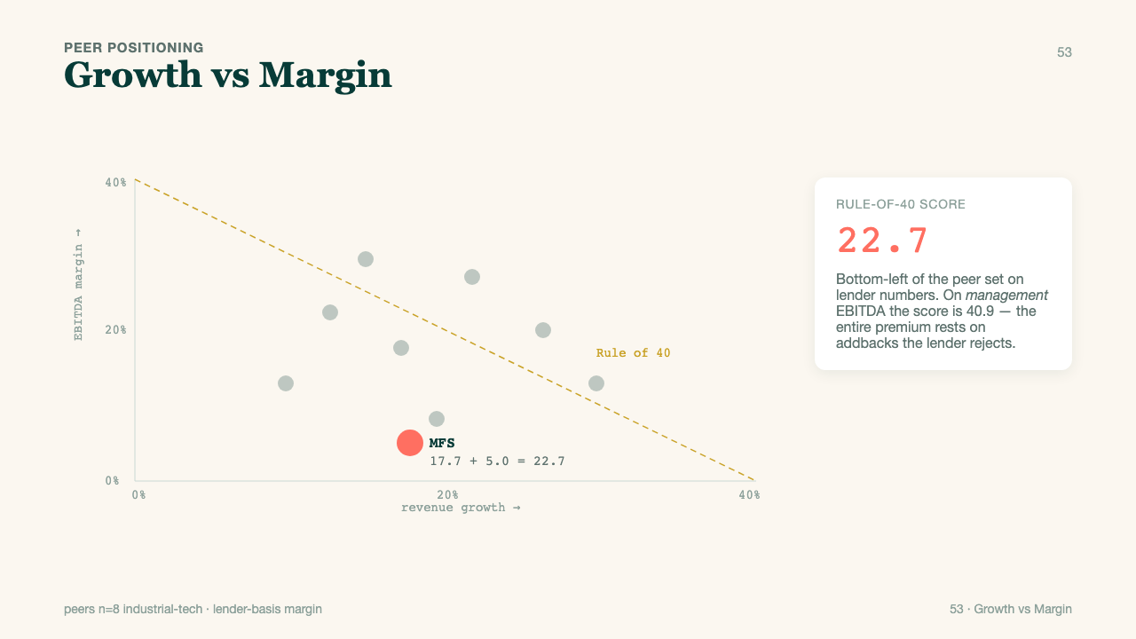
053 · fmt-53-rule40
Notes:
format_id: fmt-53-rule40
format_number: 53
title: Rule40
source_html: /Users/openclaw2/Downloads/PocketExec Slide templates/pocket_exec_01_102_final_handoff/source_assets/pocket_exec_formats_43_62_design2_v2.html
authority: files (10).zip
rendered_png: /Users/openclaw2/Downloads/PocketExec Slide templates/pocket_exec_01_102_final_handoff/rendered_template_png/053_fmt-53-rule40.png

Slide 33
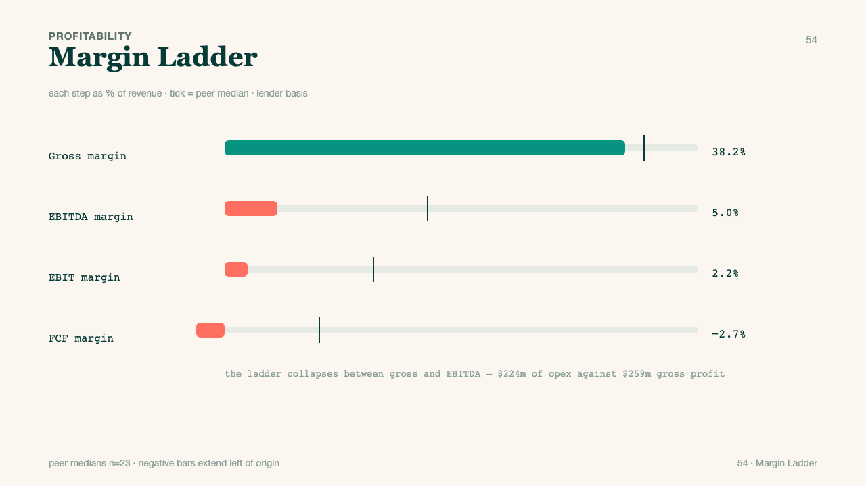
054 · fmt-54-margin-ladder
Notes:
format_id: fmt-54-margin-ladder
format_number: 54
title: Margin Ladder
source_html: /Users/openclaw2/Downloads/PocketExec Slide templates/pocket_exec_01_102_final_handoff/source_assets/pocket_exec_formats_43_62_design2_v2.html
authority: files (10).zip
rendered_png: /Users/openclaw2/Downloads/PocketExec Slide templates/pocket_exec_01_102_final_handoff/rendered_template_png/054_fmt-54-margin-ladder.png

Slide 34
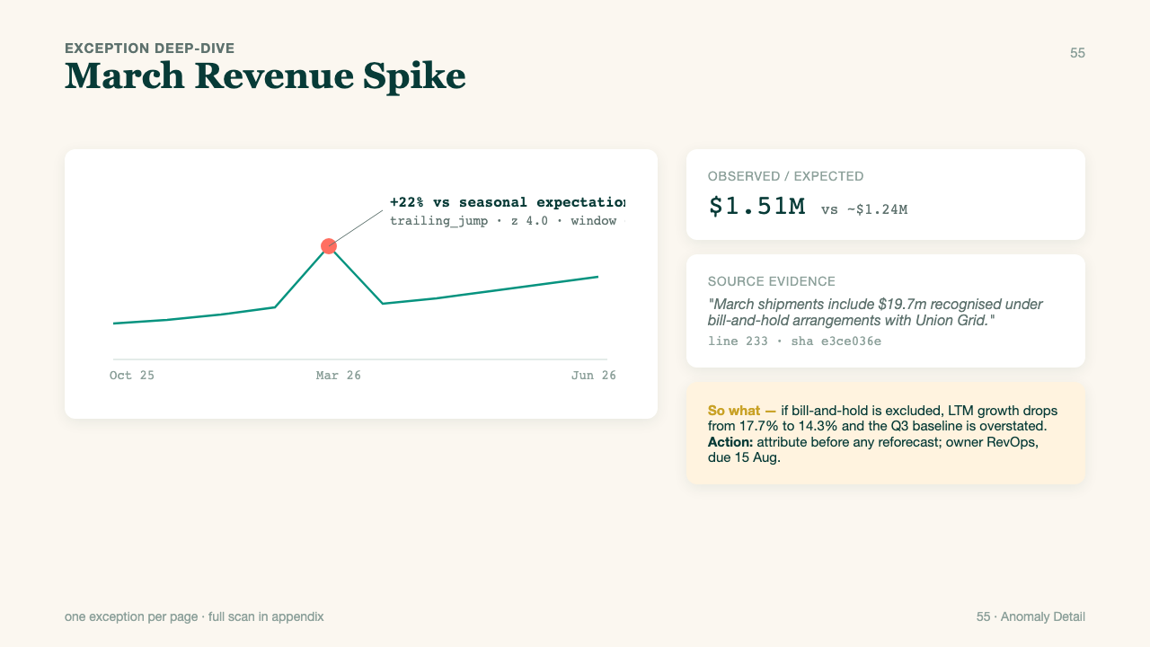
055 · fmt-55-anomaly-detail
Notes:
format_id: fmt-55-anomaly-detail
format_number: 55
title: Anomaly Detail
source_html: /Users/openclaw2/Downloads/PocketExec Slide templates/pocket_exec_01_102_final_handoff/source_assets/pocket_exec_formats_43_62_design2_v2.html
authority: files (10).zip
rendered_png: /Users/openclaw2/Downloads/PocketExec Slide templates/pocket_exec_01_102_final_handoff/rendered_template_png/055_fmt-55-anomaly-detail.png

Slide 35
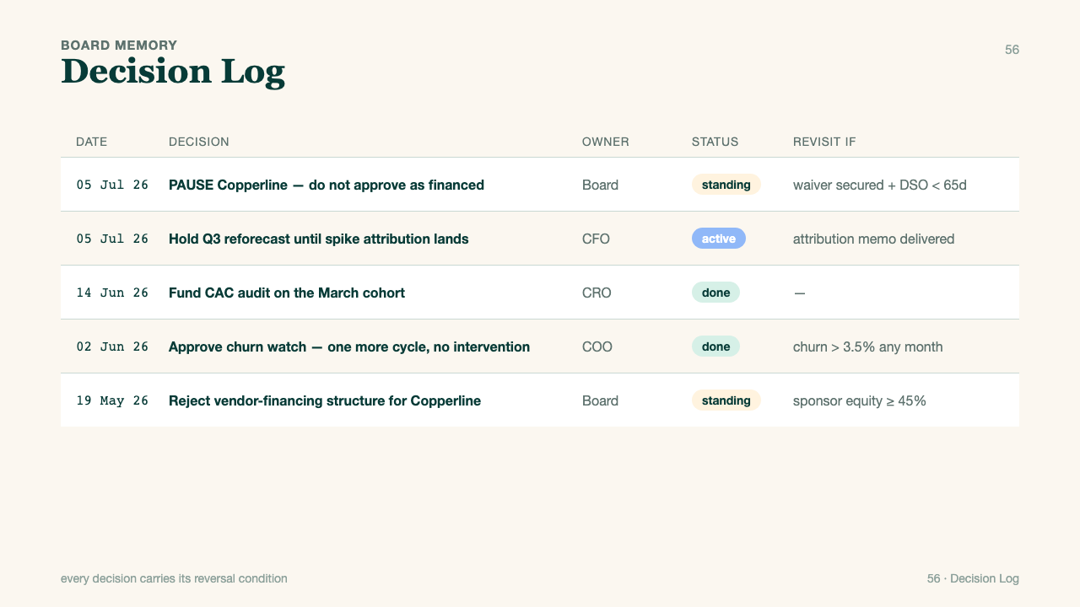
056 · fmt-56-decision-log
Notes:
format_id: fmt-56-decision-log
format_number: 56
title: Decision Log
source_html: /Users/openclaw2/Downloads/PocketExec Slide templates/pocket_exec_01_102_final_handoff/source_assets/pocket_exec_formats_43_62_design2_v2.html
authority: files (10).zip
rendered_png: /Users/openclaw2/Downloads/PocketExec Slide templates/pocket_exec_01_102_final_handoff/rendered_template_png/056_fmt-56-decision-log.png

Slide 36
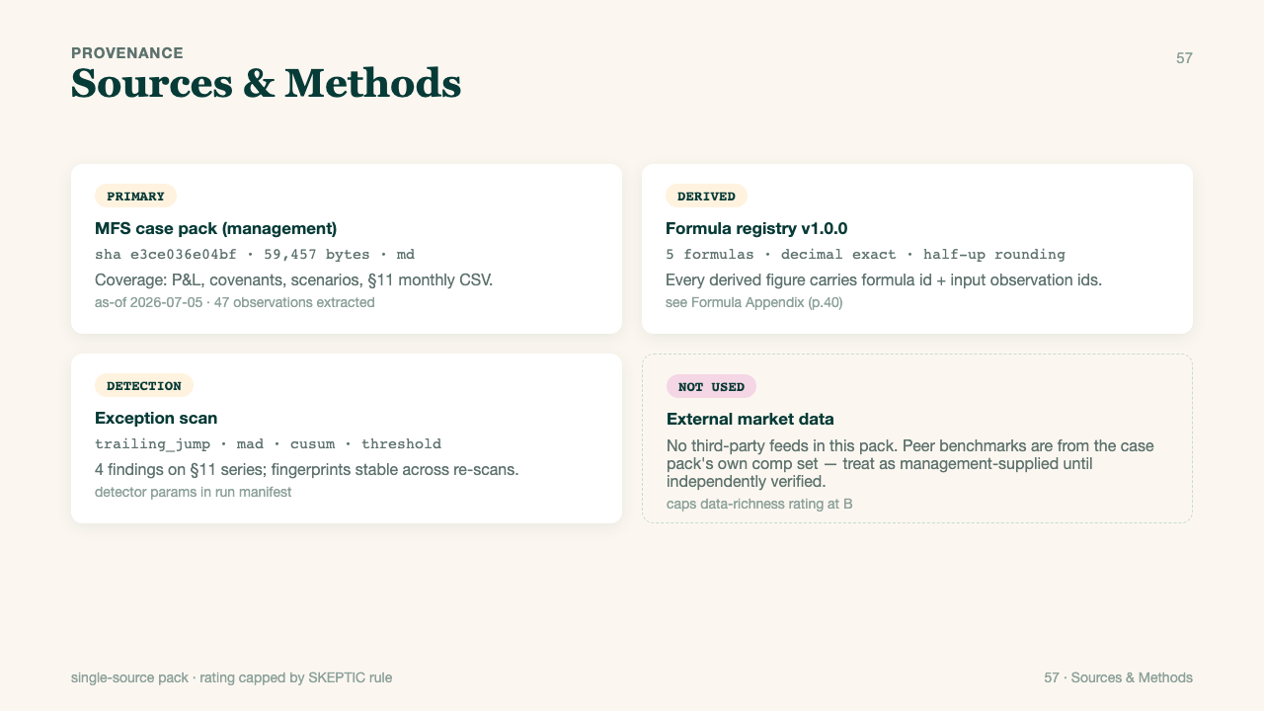
057 · fmt-57-sources-methods
Notes:
format_id: fmt-57-sources-methods
format_number: 57
title: Sources Methods
source_html: /Users/openclaw2/Downloads/PocketExec Slide templates/pocket_exec_01_102_final_handoff/source_assets/pocket_exec_formats_43_62_design2_v2.html
authority: files (10).zip
rendered_png: /Users/openclaw2/Downloads/PocketExec Slide templates/pocket_exec_01_102_final_handoff/rendered_template_png/057_fmt-57-sources-methods.png

Slide 37
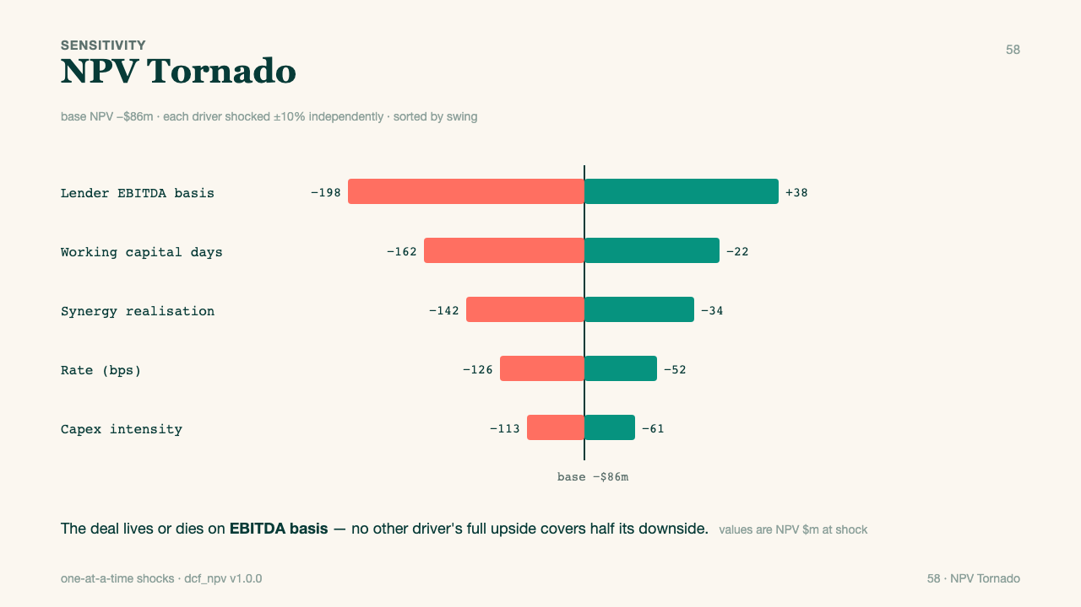
058 · fmt-58-tornado
Notes:
format_id: fmt-58-tornado
format_number: 58
title: Tornado
source_html: /Users/openclaw2/Downloads/PocketExec Slide templates/pocket_exec_01_102_final_handoff/source_assets/pocket_exec_formats_43_62_design2_v2.html
authority: files (10).zip
rendered_png: /Users/openclaw2/Downloads/PocketExec Slide templates/pocket_exec_01_102_final_handoff/rendered_template_png/058_fmt-58-tornado.png

Slide 38
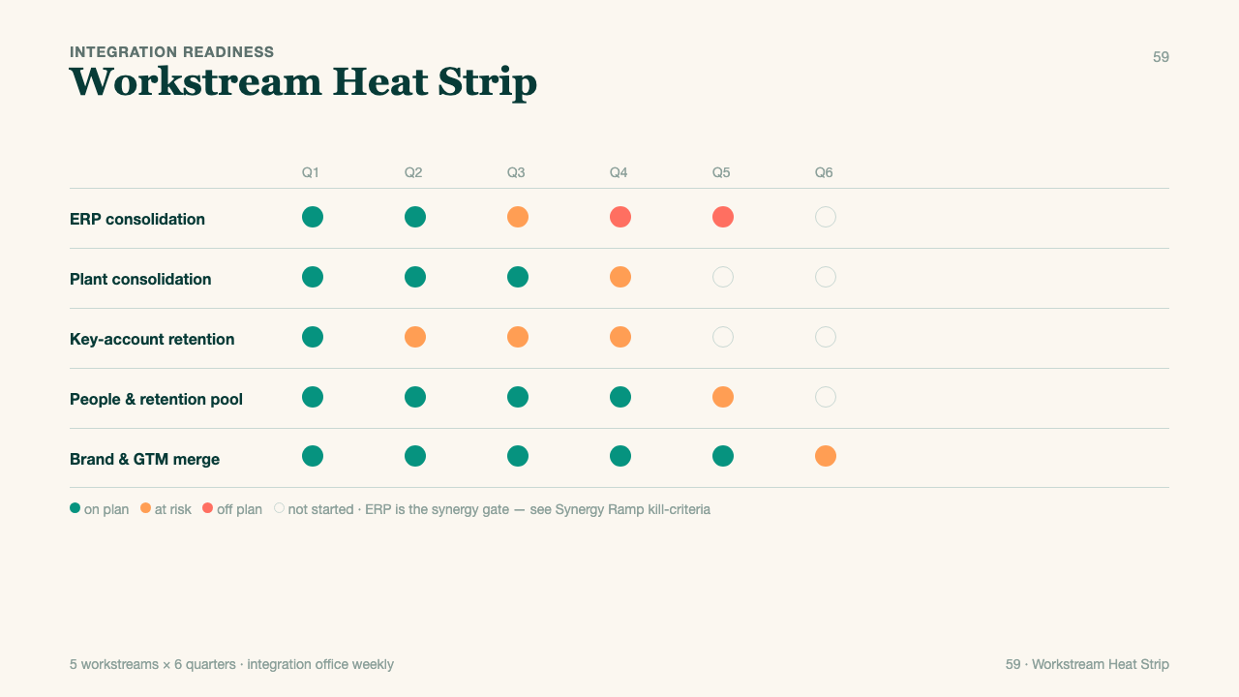
059 · fmt-59-heat-strip
Notes:
format_id: fmt-59-heat-strip
format_number: 59
title: Heat Strip
source_html: /Users/openclaw2/Downloads/PocketExec Slide templates/pocket_exec_01_102_final_handoff/source_assets/pocket_exec_formats_43_62_design2_v2.html
authority: files (10).zip
rendered_png: /Users/openclaw2/Downloads/PocketExec Slide templates/pocket_exec_01_102_final_handoff/rendered_template_png/059_fmt-59-heat-strip.png

Slide 39
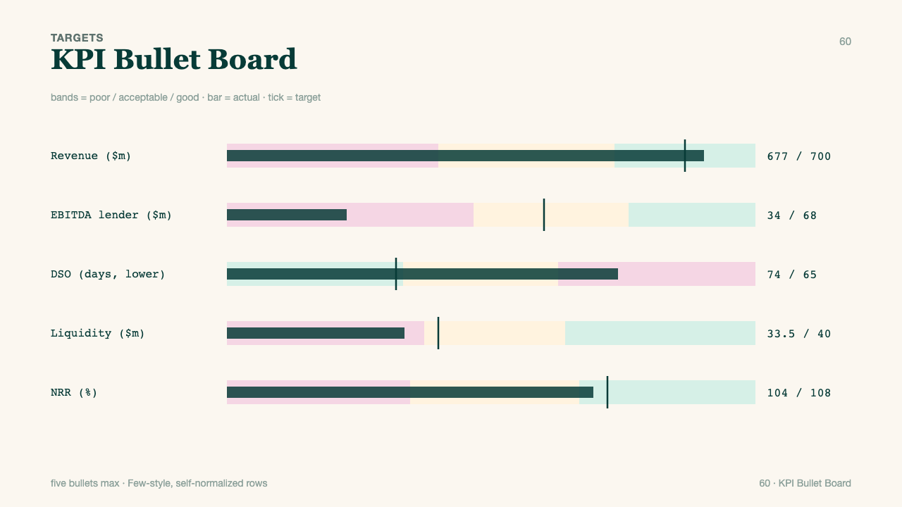
060 · fmt-60-bullet-board
Notes:
format_id: fmt-60-bullet-board
format_number: 60
title: Bullet Board
source_html: /Users/openclaw2/Downloads/PocketExec Slide templates/pocket_exec_01_102_final_handoff/source_assets/pocket_exec_formats_43_62_design2_v2.html
authority: files (10).zip
rendered_png: /Users/openclaw2/Downloads/PocketExec Slide templates/pocket_exec_01_102_final_handoff/rendered_template_png/060_fmt-60-bullet-board.png

Slide 40
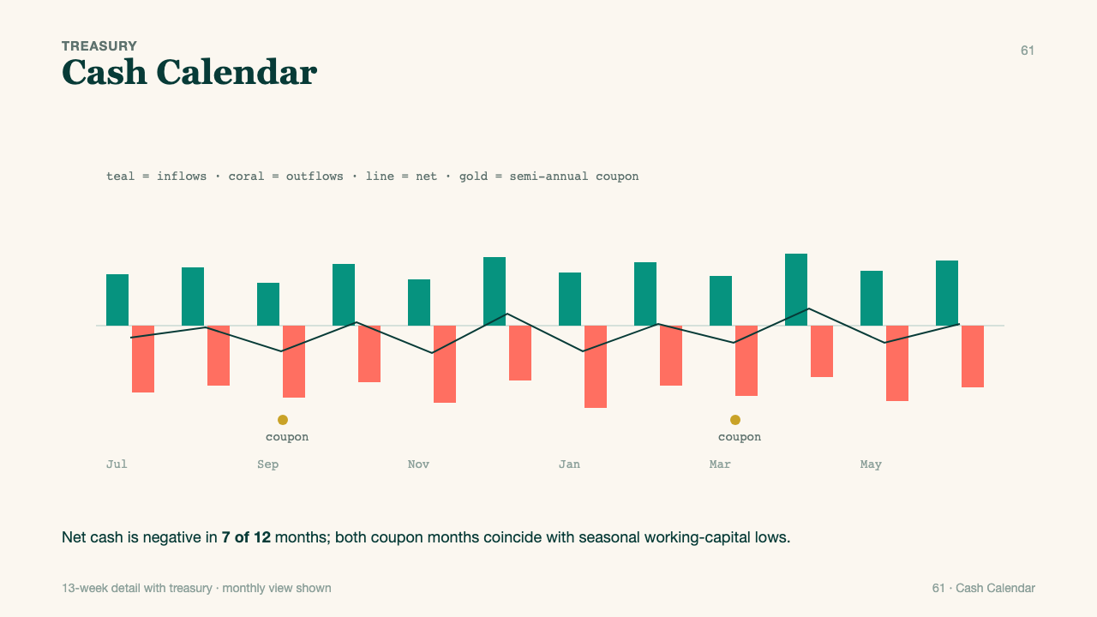
061 · fmt-61-cash-calendar
Notes:
format_id: fmt-61-cash-calendar
format_number: 61
title: Cash Calendar
source_html: /Users/openclaw2/Downloads/PocketExec Slide templates/pocket_exec_01_102_final_handoff/source_assets/pocket_exec_formats_43_62_design2_v2.html
authority: files (10).zip
rendered_png: /Users/openclaw2/Downloads/PocketExec Slide templates/pocket_exec_01_102_final_handoff/rendered_template_png/061_fmt-61-cash-calendar.png

Slide 41
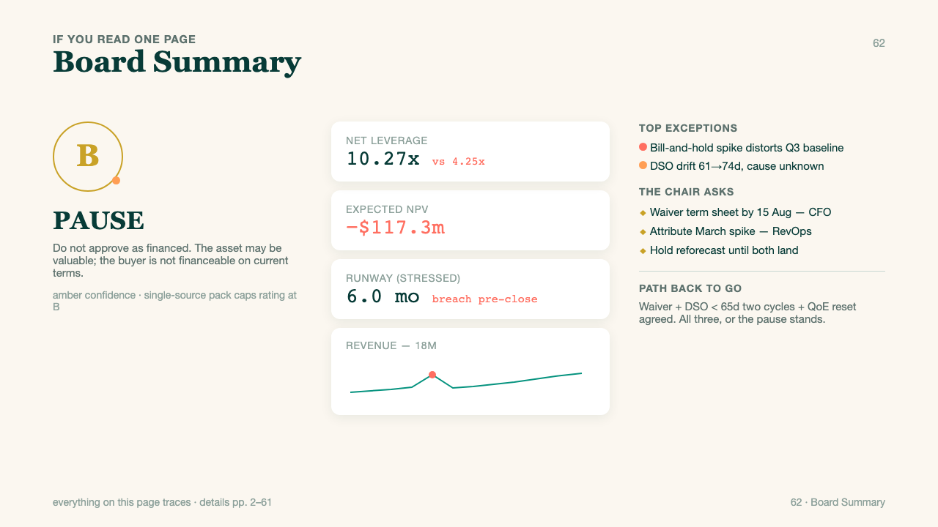
062 · fmt-62-board-summary
Notes:
format_id: fmt-62-board-summary
format_number: 62
title: Board Summary
source_html: /Users/openclaw2/Downloads/PocketExec Slide templates/pocket_exec_01_102_final_handoff/source_assets/pocket_exec_formats_43_62_design2_v2.html
authority: files (10).zip
rendered_png: /Users/openclaw2/Downloads/PocketExec Slide templates/pocket_exec_01_102_final_handoff/rendered_template_png/062_fmt-62-board-summary.png

Slide 42
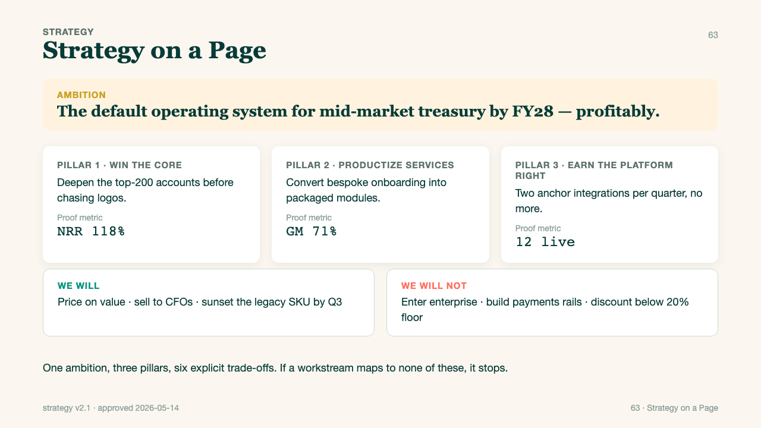
063 · fmt-63-strategy-on-a-page
Notes:
format_id: fmt-63-strategy-on-a-page
format_number: 63
title: Strategy On A Page
source_html: /Users/openclaw2/Downloads/PocketExec Slide templates/pocket_exec_01_102_final_handoff/source_assets/pocket_exec_formats_63_82_design2_v1.html
authority: standalone current
rendered_png: /Users/openclaw2/Downloads/PocketExec Slide templates/pocket_exec_01_102_final_handoff/rendered_template_png/063_fmt-63-strategy-on-a-page.png

Slide 43
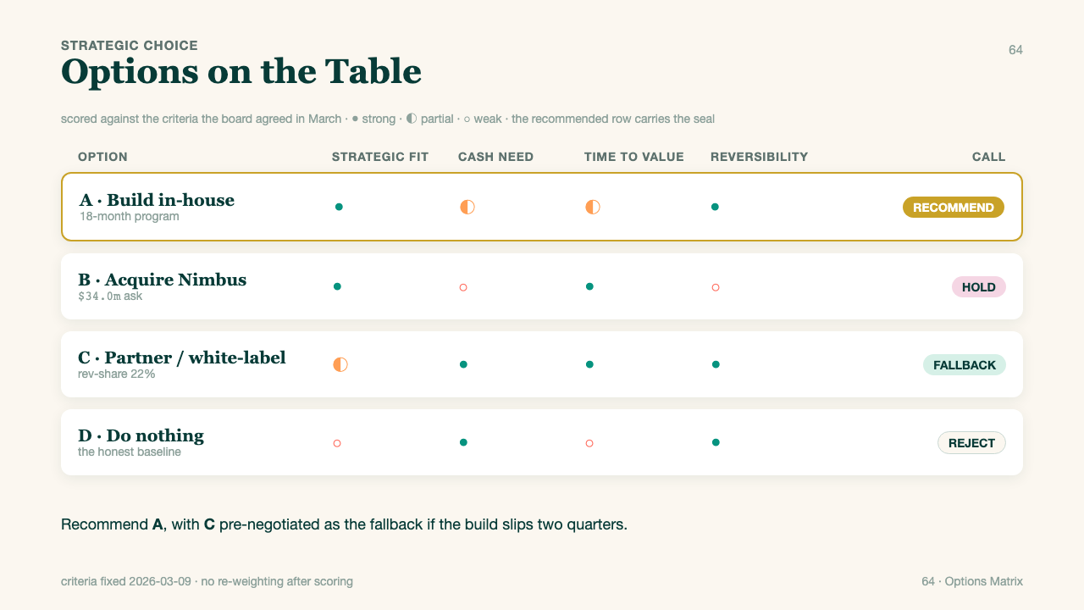
064 · fmt-64-options-matrix
Notes:
format_id: fmt-64-options-matrix
format_number: 64
title: Options Matrix
source_html: /Users/openclaw2/Downloads/PocketExec Slide templates/pocket_exec_01_102_final_handoff/source_assets/pocket_exec_formats_63_82_design2_v1.html
authority: standalone current
rendered_png: /Users/openclaw2/Downloads/PocketExec Slide templates/pocket_exec_01_102_final_handoff/rendered_template_png/064_fmt-64-options-matrix.png

Slide 44
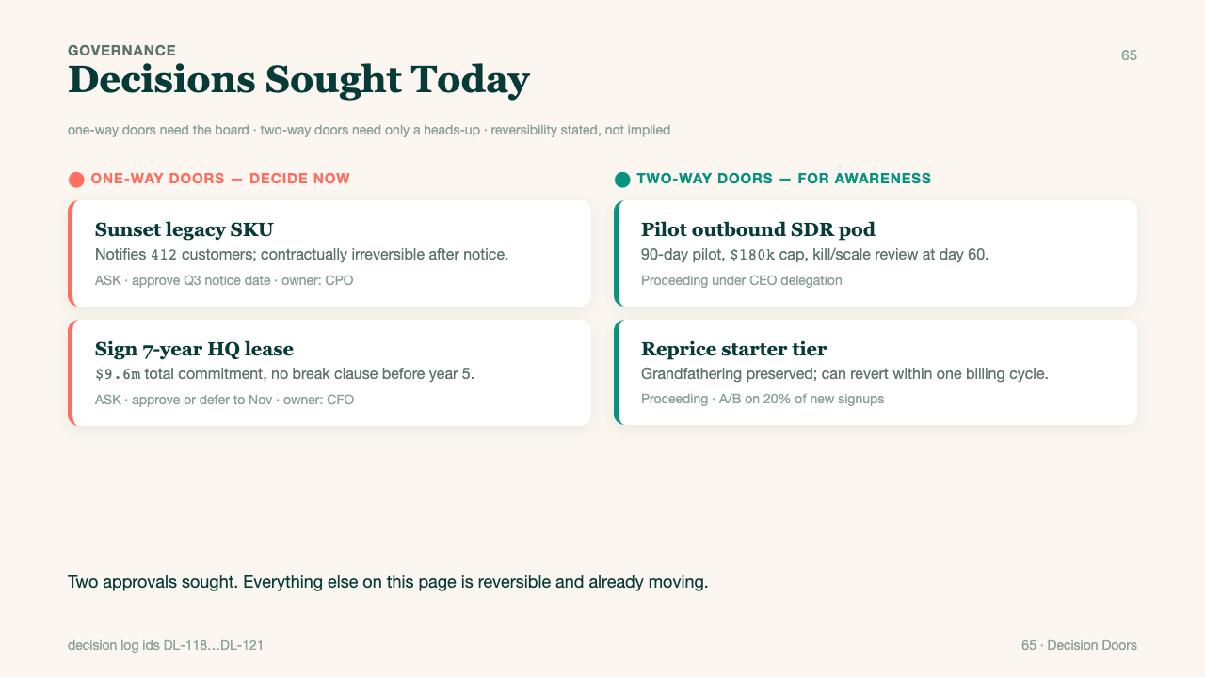
065 · fmt-65-decision-doors
Notes:
format_id: fmt-65-decision-doors
format_number: 65
title: Decision Doors
source_html: /Users/openclaw2/Downloads/PocketExec Slide templates/pocket_exec_01_102_final_handoff/source_assets/pocket_exec_formats_63_82_design2_v1.html
authority: standalone current
rendered_png: /Users/openclaw2/Downloads/PocketExec Slide templates/pocket_exec_01_102_final_handoff/rendered_template_png/065_fmt-65-decision-doors.png

Slide 45
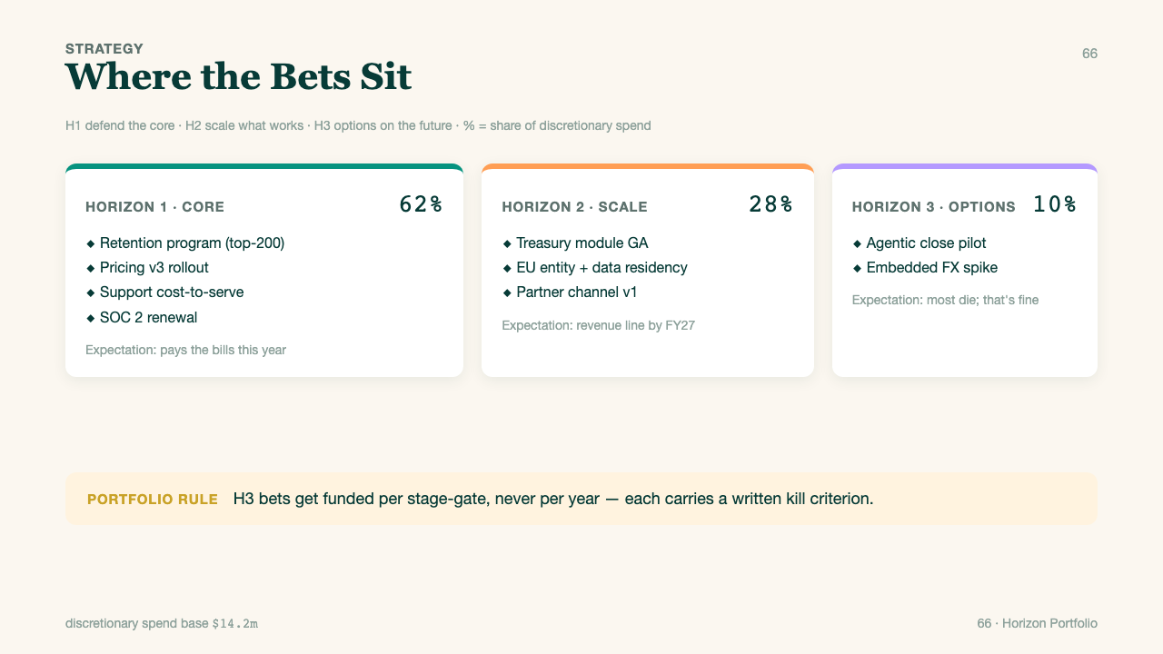
066 · fmt-66-horizon-portfolio
Notes:
format_id: fmt-66-horizon-portfolio
format_number: 66
title: Horizon Portfolio
source_html: /Users/openclaw2/Downloads/PocketExec Slide templates/pocket_exec_01_102_final_handoff/source_assets/pocket_exec_formats_63_82_design2_v1.html
authority: standalone current
rendered_png: /Users/openclaw2/Downloads/PocketExec Slide templates/pocket_exec_01_102_final_handoff/rendered_template_png/066_fmt-66-horizon-portfolio.png

Slide 46
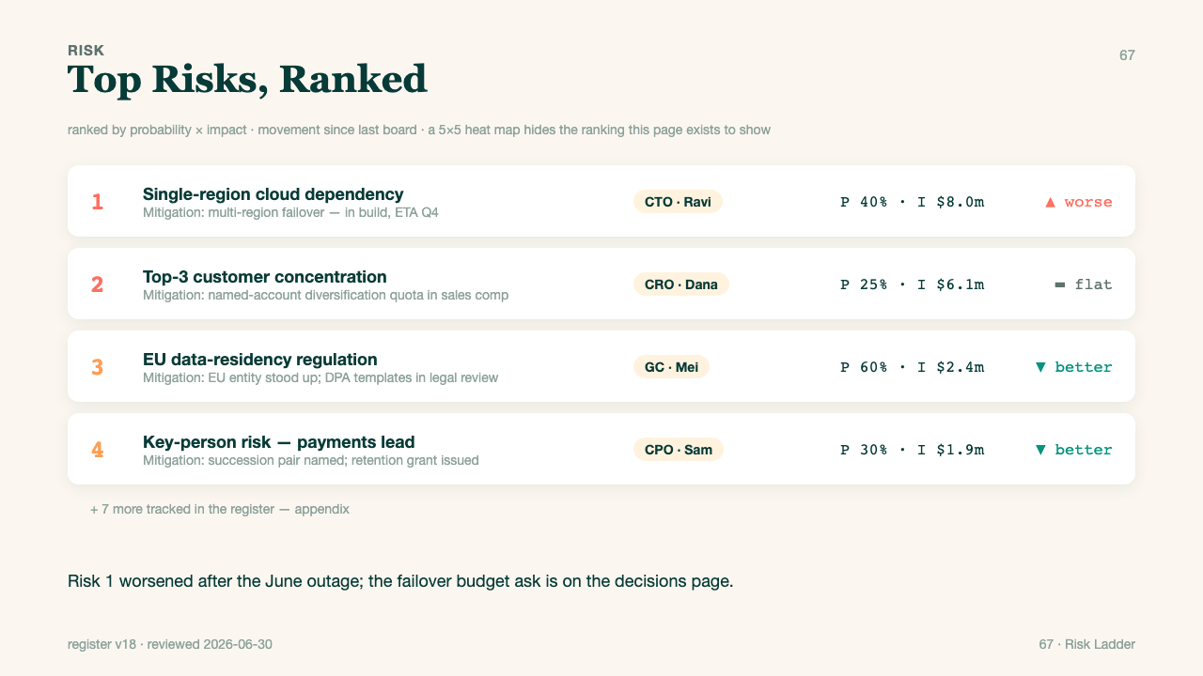
067 · fmt-67-risk-ladder
Notes:
format_id: fmt-67-risk-ladder
format_number: 67
title: Risk Ladder
source_html: /Users/openclaw2/Downloads/PocketExec Slide templates/pocket_exec_01_102_final_handoff/source_assets/pocket_exec_formats_63_82_design2_v1.html
authority: standalone current
rendered_png: /Users/openclaw2/Downloads/PocketExec Slide templates/pocket_exec_01_102_final_handoff/rendered_template_png/067_fmt-67-risk-ladder.png

Slide 47
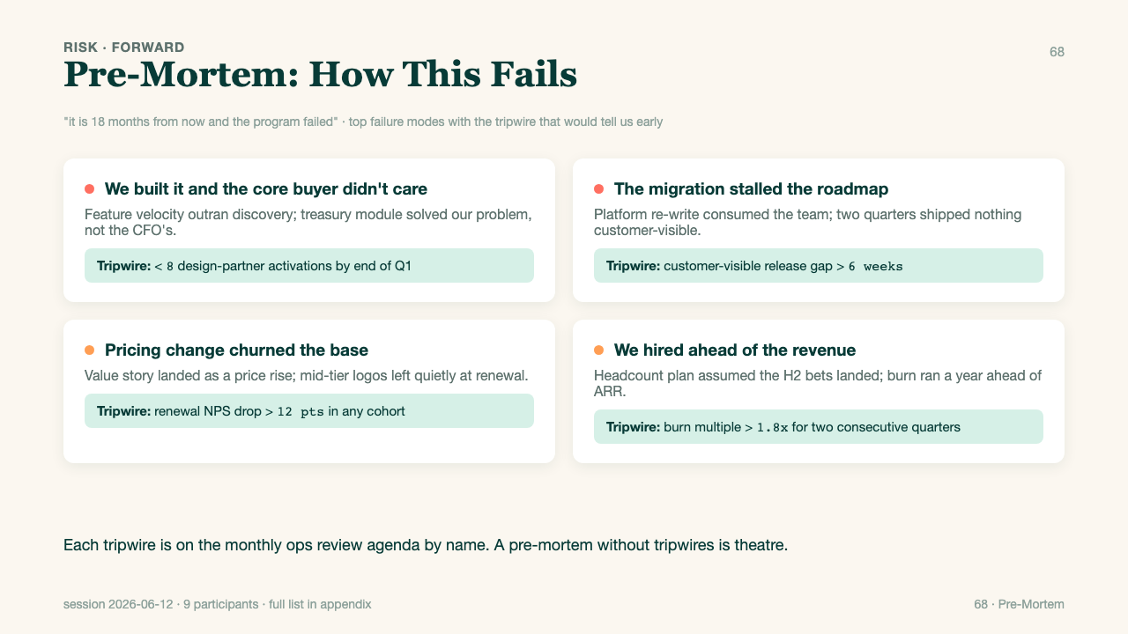
068 · fmt-68-premortem
Notes:
format_id: fmt-68-premortem
format_number: 68
title: Premortem
source_html: /Users/openclaw2/Downloads/PocketExec Slide templates/pocket_exec_01_102_final_handoff/source_assets/pocket_exec_formats_63_82_design2_v1.html
authority: standalone current
rendered_png: /Users/openclaw2/Downloads/PocketExec Slide templates/pocket_exec_01_102_final_handoff/rendered_template_png/068_fmt-68-premortem.png

Slide 48
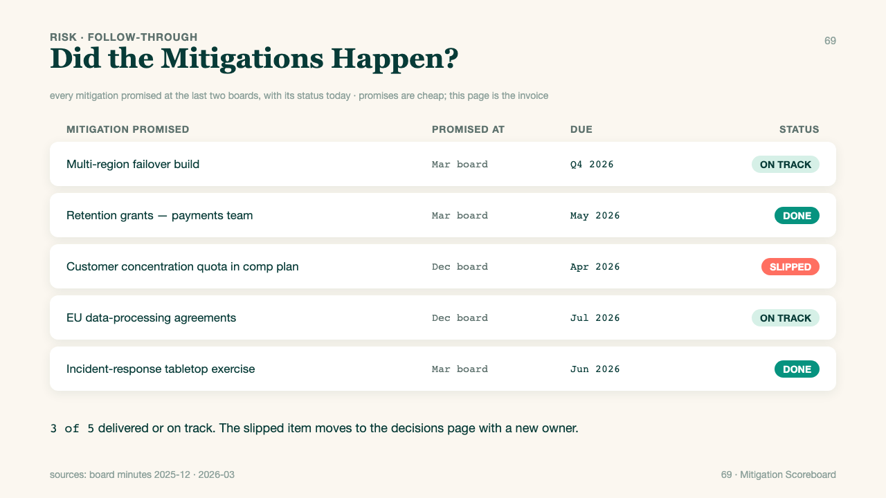
069 · fmt-69-mitigation-scoreboard
Notes:
format_id: fmt-69-mitigation-scoreboard
format_number: 69
title: Mitigation Scoreboard
source_html: /Users/openclaw2/Downloads/PocketExec Slide templates/pocket_exec_01_102_final_handoff/source_assets/pocket_exec_formats_63_82_design2_v1.html
authority: standalone current
rendered_png: /Users/openclaw2/Downloads/PocketExec Slide templates/pocket_exec_01_102_final_handoff/rendered_template_png/069_fmt-69-mitigation-scoreboard.png

Slide 49
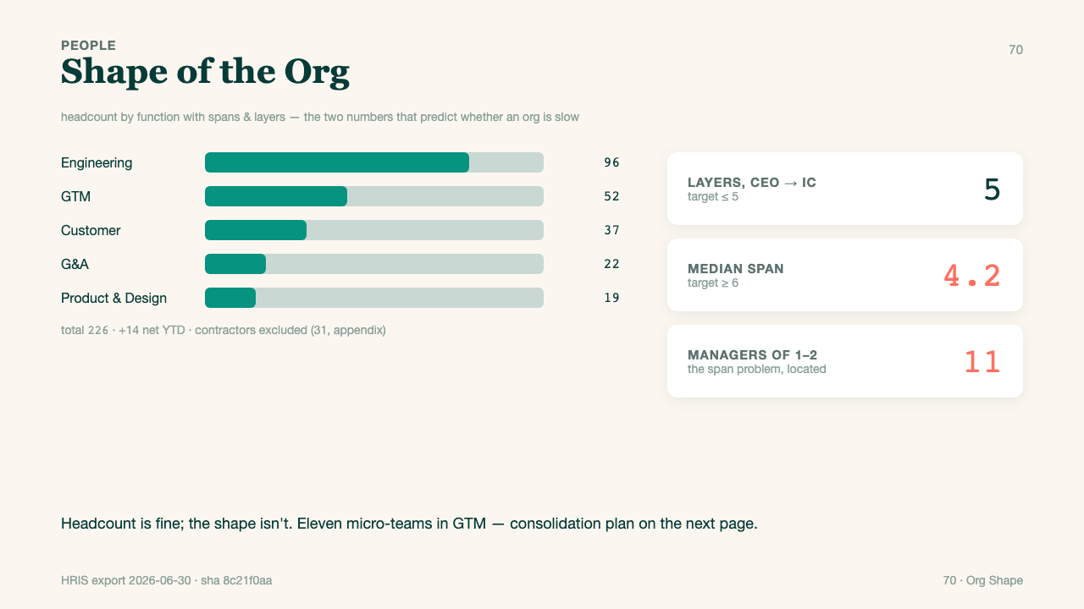
070 · fmt-70-org-shape
Notes:
format_id: fmt-70-org-shape
format_number: 70
title: Org Shape
source_html: /Users/openclaw2/Downloads/PocketExec Slide templates/pocket_exec_01_102_final_handoff/source_assets/pocket_exec_formats_63_82_design2_v1.html
authority: standalone current
rendered_png: /Users/openclaw2/Downloads/PocketExec Slide templates/pocket_exec_01_102_final_handoff/rendered_template_png/070_fmt-70-org-shape.png

Slide 50
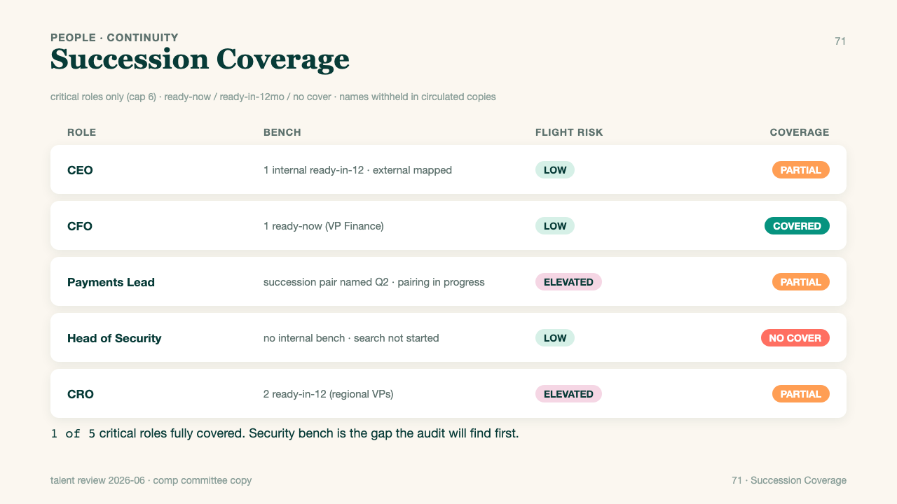
071 · fmt-71-succession-coverage
Notes:
format_id: fmt-71-succession-coverage
format_number: 71
title: Succession Coverage
source_html: /Users/openclaw2/Downloads/PocketExec Slide templates/pocket_exec_01_102_final_handoff/source_assets/pocket_exec_formats_63_82_design2_v1.html
authority: standalone current
rendered_png: /Users/openclaw2/Downloads/PocketExec Slide templates/pocket_exec_01_102_final_handoff/rendered_template_png/071_fmt-71-succession-coverage.png

Slide 51
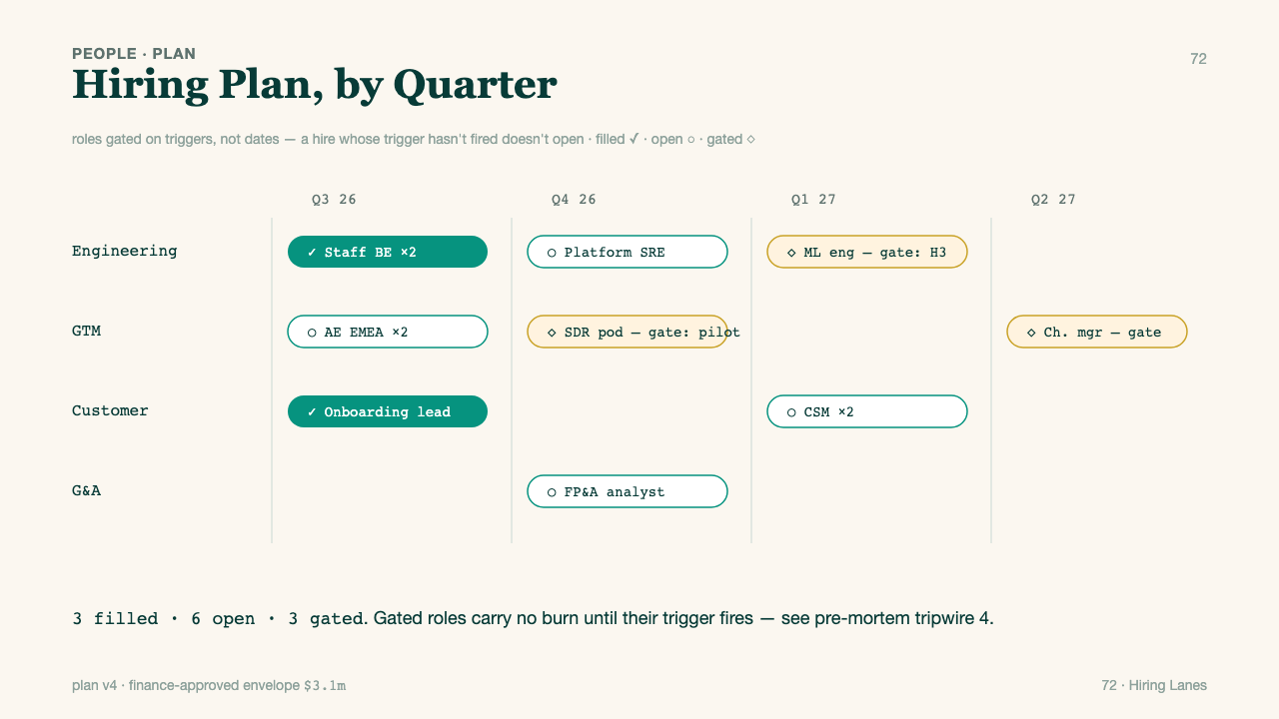
072 · fmt-72-hiring-lanes
Notes:
format_id: fmt-72-hiring-lanes
format_number: 72
title: Hiring Lanes
source_html: /Users/openclaw2/Downloads/PocketExec Slide templates/pocket_exec_01_102_final_handoff/source_assets/pocket_exec_formats_63_82_design2_v1.html
authority: standalone current
rendered_png: /Users/openclaw2/Downloads/PocketExec Slide templates/pocket_exec_01_102_final_handoff/rendered_template_png/072_fmt-72-hiring-lanes.png

Slide 52
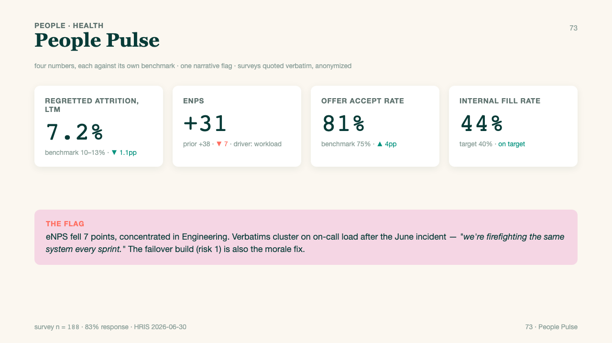
073 · fmt-73-people-pulse
Notes:
format_id: fmt-73-people-pulse
format_number: 73
title: People Pulse
source_html: /Users/openclaw2/Downloads/PocketExec Slide templates/pocket_exec_01_102_final_handoff/source_assets/pocket_exec_formats_63_82_design2_v1.html
authority: standalone current
rendered_png: /Users/openclaw2/Downloads/PocketExec Slide templates/pocket_exec_01_102_final_handoff/rendered_template_png/073_fmt-73-people-pulse.png

Slide 53

074 · fmt-74-decision-rights
Notes:
format_id: fmt-74-decision-rights
format_number: 74
title: Decision Rights
source_html: /Users/openclaw2/Downloads/PocketExec Slide templates/pocket_exec_01_102_final_handoff/source_assets/pocket_exec_formats_63_82_design2_v1.html
authority: standalone current
rendered_png: /Users/openclaw2/Downloads/PocketExec Slide templates/pocket_exec_01_102_final_handoff/rendered_template_png/074_fmt-74-decision-rights.png

Slide 54

075 · fmt-75-operating-cadence
Notes:
format_id: fmt-75-operating-cadence
format_number: 75
title: Operating Cadence
source_html: /Users/openclaw2/Downloads/PocketExec Slide templates/pocket_exec_01_102_final_handoff/source_assets/pocket_exec_formats_63_82_design2_v1.html
authority: standalone current
rendered_png: /Users/openclaw2/Downloads/PocketExec Slide templates/pocket_exec_01_102_final_handoff/rendered_template_png/075_fmt-75-operating-cadence.png

Slide 55

076 · fmt-76-stakeholder-tiles
Notes:
format_id: fmt-76-stakeholder-tiles
format_number: 76
title: Stakeholder Tiles
source_html: /Users/openclaw2/Downloads/PocketExec Slide templates/pocket_exec_01_102_final_handoff/source_assets/pocket_exec_formats_63_82_design2_v1.html
authority: standalone current
rendered_png: /Users/openclaw2/Downloads/PocketExec Slide templates/pocket_exec_01_102_final_handoff/rendered_template_png/076_fmt-76-stakeholder-tiles.png

Slide 56

077 · fmt-77-comms-ladder
Notes:
format_id: fmt-77-comms-ladder
format_number: 77
title: Comms Ladder
source_html: /Users/openclaw2/Downloads/PocketExec Slide templates/pocket_exec_01_102_final_handoff/source_assets/pocket_exec_formats_63_82_design2_v1.html
authority: standalone current
rendered_png: /Users/openclaw2/Downloads/PocketExec Slide templates/pocket_exec_01_102_final_handoff/rendered_template_png/077_fmt-77-comms-ladder.png

Slide 57

078 · fmt-78-transformation-lanes
Notes:
format_id: fmt-78-transformation-lanes
format_number: 78
title: Transformation Lanes
source_html: /Users/openclaw2/Downloads/PocketExec Slide templates/pocket_exec_01_102_final_handoff/source_assets/pocket_exec_formats_63_82_design2_v1.html
authority: standalone current
rendered_png: /Users/openclaw2/Downloads/PocketExec Slide templates/pocket_exec_01_102_final_handoff/rendered_template_png/078_fmt-78-transformation-lanes.png

Slide 58

079 · fmt-79-culture-commitments
Notes:
format_id: fmt-79-culture-commitments
format_number: 79
title: Culture Commitments
source_html: /Users/openclaw2/Downloads/PocketExec Slide templates/pocket_exec_01_102_final_handoff/source_assets/pocket_exec_formats_63_82_design2_v1.html
authority: standalone current
rendered_png: /Users/openclaw2/Downloads/PocketExec Slide templates/pocket_exec_01_102_final_handoff/rendered_template_png/079_fmt-79-culture-commitments.png

Slide 59

080 · fmt-80-board-asks
Notes:
format_id: fmt-80-board-asks
format_number: 80
title: Board Asks
source_html: /Users/openclaw2/Downloads/PocketExec Slide templates/pocket_exec_01_102_final_handoff/source_assets/pocket_exec_formats_63_82_design2_v1.html
authority: standalone current
rendered_png: /Users/openclaw2/Downloads/PocketExec Slide templates/pocket_exec_01_102_final_handoff/rendered_template_png/080_fmt-80-board-asks.png

Slide 60

081 · fmt-81-play-to-win
Notes:
format_id: fmt-81-play-to-win
format_number: 81
title: Play To Win
source_html: /Users/openclaw2/Downloads/PocketExec Slide templates/pocket_exec_01_102_final_handoff/source_assets/pocket_exec_formats_63_82_design2_v1.html
authority: standalone current
rendered_png: /Users/openclaw2/Downloads/PocketExec Slide templates/pocket_exec_01_102_final_handoff/rendered_template_png/081_fmt-81-play-to-win.png

Slide 61

082 · fmt-82-quarter-scorecard
Notes:
format_id: fmt-82-quarter-scorecard
format_number: 82
title: Quarter Scorecard
source_html: /Users/openclaw2/Downloads/PocketExec Slide templates/pocket_exec_01_102_final_handoff/source_assets/pocket_exec_formats_63_82_design2_v1.html
authority: standalone current
rendered_png: /Users/openclaw2/Downloads/PocketExec Slide templates/pocket_exec_01_102_final_handoff/rendered_template_png/082_fmt-82-quarter-scorecard.png

Slide 62

083 · fmt-83-deal-rationale
Notes:
format_id: fmt-83-deal-rationale
format_number: 83
title: Deal Rationale
source_html: /Users/openclaw2/Downloads/PocketExec Slide templates/pocket_exec_01_102_final_handoff/source_assets/pocket_exec_formats_83_102_design2_v1.html
authority: standalone current
rendered_png: /Users/openclaw2/Downloads/PocketExec Slide templates/pocket_exec_01_102_final_handoff/rendered_template_png/083_fmt-83-deal-rationale.png

Slide 63

084 · fmt-84-integration-scorecard
Notes:
format_id: fmt-84-integration-scorecard
format_number: 84
title: Integration Scorecard
source_html: /Users/openclaw2/Downloads/PocketExec Slide templates/pocket_exec_01_102_final_handoff/source_assets/pocket_exec_formats_83_102_design2_v1.html
authority: standalone current
rendered_png: /Users/openclaw2/Downloads/PocketExec Slide templates/pocket_exec_01_102_final_handoff/rendered_template_png/084_fmt-84-integration-scorecard.png

Slide 64

085 · fmt-85-customer-voice
Notes:
format_id: fmt-85-customer-voice
format_number: 85
title: Customer Voice
source_html: /Users/openclaw2/Downloads/PocketExec Slide templates/pocket_exec_01_102_final_handoff/source_assets/pocket_exec_formats_83_102_design2_v1.html
authority: standalone current
rendered_png: /Users/openclaw2/Downloads/PocketExec Slide templates/pocket_exec_01_102_final_handoff/rendered_template_png/085_fmt-85-customer-voice.png

Slide 65

086 · fmt-86-win-loss
Notes:
format_id: fmt-86-win-loss
format_number: 86
title: Win Loss
source_html: /Users/openclaw2/Downloads/PocketExec Slide templates/pocket_exec_01_102_final_handoff/source_assets/pocket_exec_formats_83_102_design2_v1.html
authority: standalone current
rendered_png: /Users/openclaw2/Downloads/PocketExec Slide templates/pocket_exec_01_102_final_handoff/rendered_template_png/086_fmt-86-win-loss.png

Slide 66

087 · fmt-87-product-shelf
Notes:
format_id: fmt-87-product-shelf
format_number: 87
title: Product Shelf
source_html: /Users/openclaw2/Downloads/PocketExec Slide templates/pocket_exec_01_102_final_handoff/source_assets/pocket_exec_formats_83_102_design2_v1.html
authority: standalone current
rendered_png: /Users/openclaw2/Downloads/PocketExec Slide templates/pocket_exec_01_102_final_handoff/rendered_template_png/087_fmt-87-product-shelf.png

Slide 67

088 · fmt-88-roadmap-honesty
Notes:
format_id: fmt-88-roadmap-honesty
format_number: 88
title: Roadmap Honesty
source_html: /Users/openclaw2/Downloads/PocketExec Slide templates/pocket_exec_01_102_final_handoff/source_assets/pocket_exec_formats_83_102_design2_v1.html
authority: standalone current
rendered_png: /Users/openclaw2/Downloads/PocketExec Slide templates/pocket_exec_01_102_final_handoff/rendered_template_png/088_fmt-88-roadmap-honesty.png

Slide 68

089 · fmt-89-compliance-posture
Notes:
format_id: fmt-89-compliance-posture
format_number: 89
title: Compliance Posture
source_html: /Users/openclaw2/Downloads/PocketExec Slide templates/pocket_exec_01_102_final_handoff/source_assets/pocket_exec_formats_83_102_design2_v1.html
authority: standalone current
rendered_png: /Users/openclaw2/Downloads/PocketExec Slide templates/pocket_exec_01_102_final_handoff/rendered_template_png/089_fmt-89-compliance-posture.png

Slide 69

090 · fmt-90-incident-postmortem
Notes:
format_id: fmt-90-incident-postmortem
format_number: 90
title: Incident Postmortem
source_html: /Users/openclaw2/Downloads/PocketExec Slide templates/pocket_exec_01_102_final_handoff/source_assets/pocket_exec_formats_83_102_design2_v1.html
authority: standalone current
rendered_png: /Users/openclaw2/Downloads/PocketExec Slide templates/pocket_exec_01_102_final_handoff/rendered_template_png/090_fmt-90-incident-postmortem.png

Slide 70

091 · fmt-91-competitor-moves
Notes:
format_id: fmt-91-competitor-moves
format_number: 91
title: Competitor Moves
source_html: /Users/openclaw2/Downloads/PocketExec Slide templates/pocket_exec_01_102_final_handoff/source_assets/pocket_exec_formats_83_102_design2_v1.html
authority: standalone current
rendered_png: /Users/openclaw2/Downloads/PocketExec Slide templates/pocket_exec_01_102_final_handoff/rendered_template_png/091_fmt-91-competitor-moves.png

Slide 71

092 · fmt-92-capital-queue
Notes:
format_id: fmt-92-capital-queue
format_number: 92
title: Capital Queue
source_html: /Users/openclaw2/Downloads/PocketExec Slide templates/pocket_exec_01_102_final_handoff/source_assets/pocket_exec_formats_83_102_design2_v1.html
authority: standalone current
rendered_png: /Users/openclaw2/Downloads/PocketExec Slide templates/pocket_exec_01_102_final_handoff/rendered_template_png/092_fmt-92-capital-queue.png

Slide 72

093 · fmt-93-board-calendar
Notes:
format_id: fmt-93-board-calendar
format_number: 93
title: Board Calendar
source_html: /Users/openclaw2/Downloads/PocketExec Slide templates/pocket_exec_01_102_final_handoff/source_assets/pocket_exec_formats_83_102_design2_v1.html
authority: standalone current
rendered_png: /Users/openclaw2/Downloads/PocketExec Slide templates/pocket_exec_01_102_final_handoff/rendered_template_png/093_fmt-93-board-calendar.png

Slide 73

094 · fmt-94-partner-scoreboard
Notes:
format_id: fmt-94-partner-scoreboard
format_number: 94
title: Partner Scoreboard
source_html: /Users/openclaw2/Downloads/PocketExec Slide templates/pocket_exec_01_102_final_handoff/source_assets/pocket_exec_formats_83_102_design2_v1.html
authority: standalone current
rendered_png: /Users/openclaw2/Downloads/PocketExec Slide templates/pocket_exec_01_102_final_handoff/rendered_template_png/094_fmt-94-partner-scoreboard.png

Slide 74

095 · fmt-95-signals-watchlist
Notes:
format_id: fmt-95-signals-watchlist
format_number: 95
title: Signals Watchlist
source_html: /Users/openclaw2/Downloads/PocketExec Slide templates/pocket_exec_01_102_final_handoff/source_assets/pocket_exec_formats_83_102_design2_v1.html
authority: standalone current
rendered_png: /Users/openclaw2/Downloads/PocketExec Slide templates/pocket_exec_01_102_final_handoff/rendered_template_png/095_fmt-95-signals-watchlist.png

Slide 75

096 · fmt-96-pricing-posture
Notes:
format_id: fmt-96-pricing-posture
format_number: 96
title: Pricing Posture
source_html: /Users/openclaw2/Downloads/PocketExec Slide templates/pocket_exec_01_102_final_handoff/source_assets/pocket_exec_formats_83_102_design2_v1.html
authority: standalone current
rendered_png: /Users/openclaw2/Downloads/PocketExec Slide templates/pocket_exec_01_102_final_handoff/rendered_template_png/096_fmt-96-pricing-posture.png

Slide 76

097 · fmt-97-exceptions-register
Notes:
format_id: fmt-97-exceptions-register
format_number: 97
title: Exceptions Register
source_html: /Users/openclaw2/Downloads/PocketExec Slide templates/pocket_exec_01_102_final_handoff/source_assets/pocket_exec_formats_83_102_design2_v1.html
authority: standalone current
rendered_png: /Users/openclaw2/Downloads/PocketExec Slide templates/pocket_exec_01_102_final_handoff/rendered_template_png/097_fmt-97-exceptions-register.png

Slide 77

098 · fmt-98-talent-moves
Notes:
format_id: fmt-98-talent-moves
format_number: 98
title: Talent Moves
source_html: /Users/openclaw2/Downloads/PocketExec Slide templates/pocket_exec_01_102_final_handoff/source_assets/pocket_exec_formats_83_102_design2_v1.html
authority: standalone current
rendered_png: /Users/openclaw2/Downloads/PocketExec Slide templates/pocket_exec_01_102_final_handoff/rendered_template_png/098_fmt-98-talent-moves.png

Slide 78

099 · fmt-99-scenario-playbook
Notes:
format_id: fmt-99-scenario-playbook
format_number: 99
title: Scenario Playbook
source_html: /Users/openclaw2/Downloads/PocketExec Slide templates/pocket_exec_01_102_final_handoff/source_assets/pocket_exec_formats_83_102_design2_v1.html
authority: standalone current
rendered_png: /Users/openclaw2/Downloads/PocketExec Slide templates/pocket_exec_01_102_final_handoff/rendered_template_png/099_fmt-99-scenario-playbook.png

Slide 79

100 · fmt-100-program-charter
Notes:
format_id: fmt-100-program-charter
format_number: 100
title: Program Charter
source_html: /Users/openclaw2/Downloads/PocketExec Slide templates/pocket_exec_01_102_final_handoff/source_assets/pocket_exec_formats_83_102_design2_v1.html
authority: standalone current
rendered_png: /Users/openclaw2/Downloads/PocketExec Slide templates/pocket_exec_01_102_final_handoff/rendered_template_png/100_fmt-100-program-charter.png

Slide 80

101 · fmt-101-regulatory-watch
Notes:
format_id: fmt-101-regulatory-watch
format_number: 101
title: Regulatory Watch
source_html: /Users/openclaw2/Downloads/PocketExec Slide templates/pocket_exec_01_102_final_handoff/source_assets/pocket_exec_formats_83_102_design2_v1.html
authority: standalone current
rendered_png: /Users/openclaw2/Downloads/PocketExec Slide templates/pocket_exec_01_102_final_handoff/rendered_template_png/101_fmt-101-regulatory-watch.png

Slide 81

102 · fmt-102-year-ago-ledger
Notes:
format_id: fmt-102-year-ago-ledger
format_number: 102
title: Year Ago Ledger
source_html: /Users/openclaw2/Downloads/PocketExec Slide templates/pocket_exec_01_102_final_handoff/source_assets/pocket_exec_formats_83_102_design2_v1.html
authority: standalone current
rendered_png: /Users/openclaw2/Downloads/PocketExec Slide templates/pocket_exec_01_102_final_handoff/rendered_template_png/102_fmt-102-year-ago-ledger.png

